Slide 1
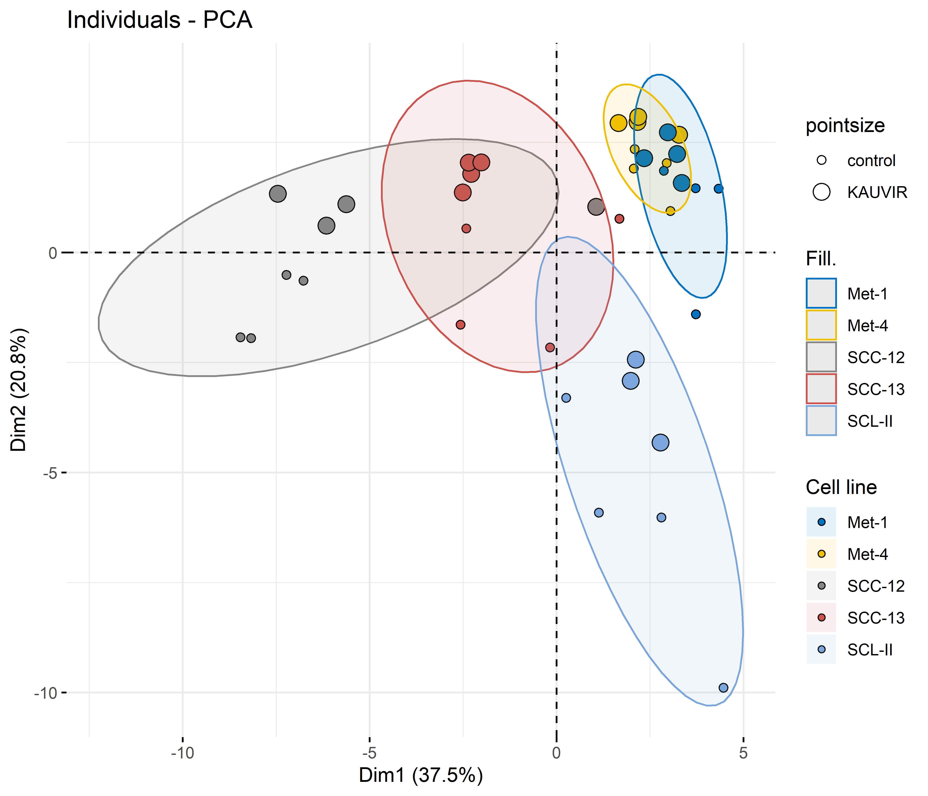
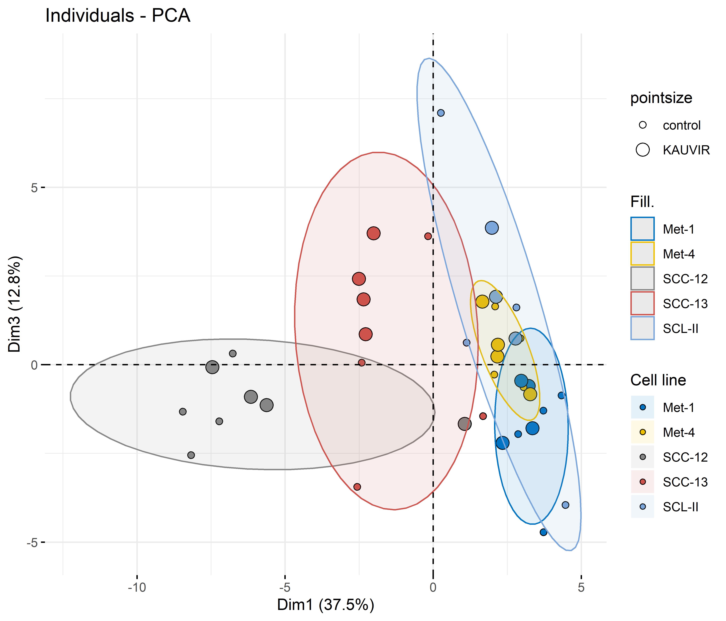
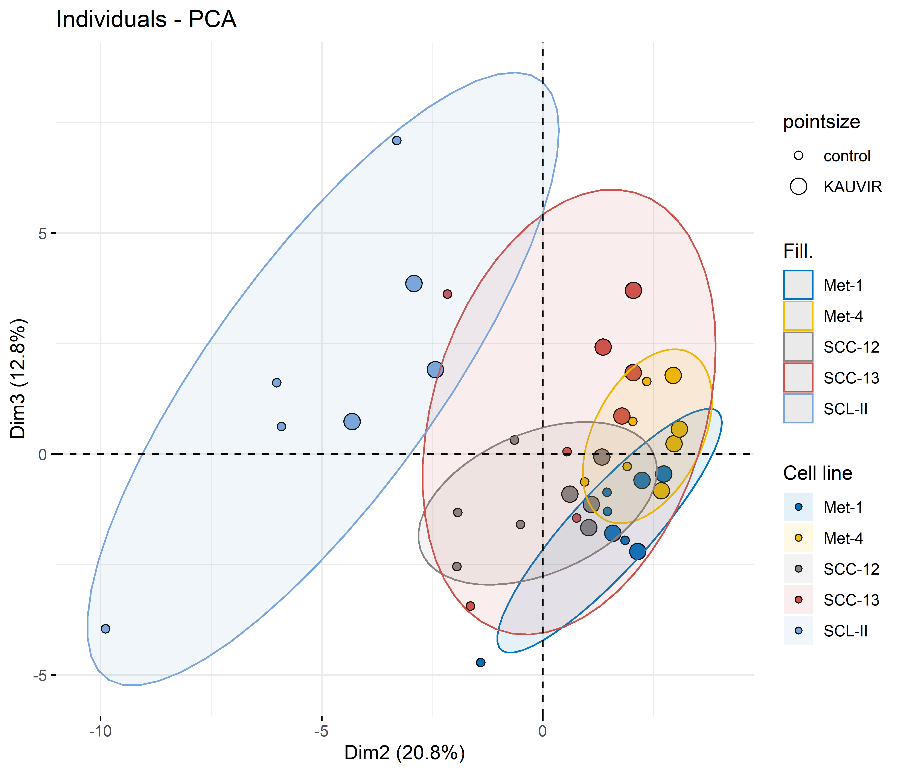
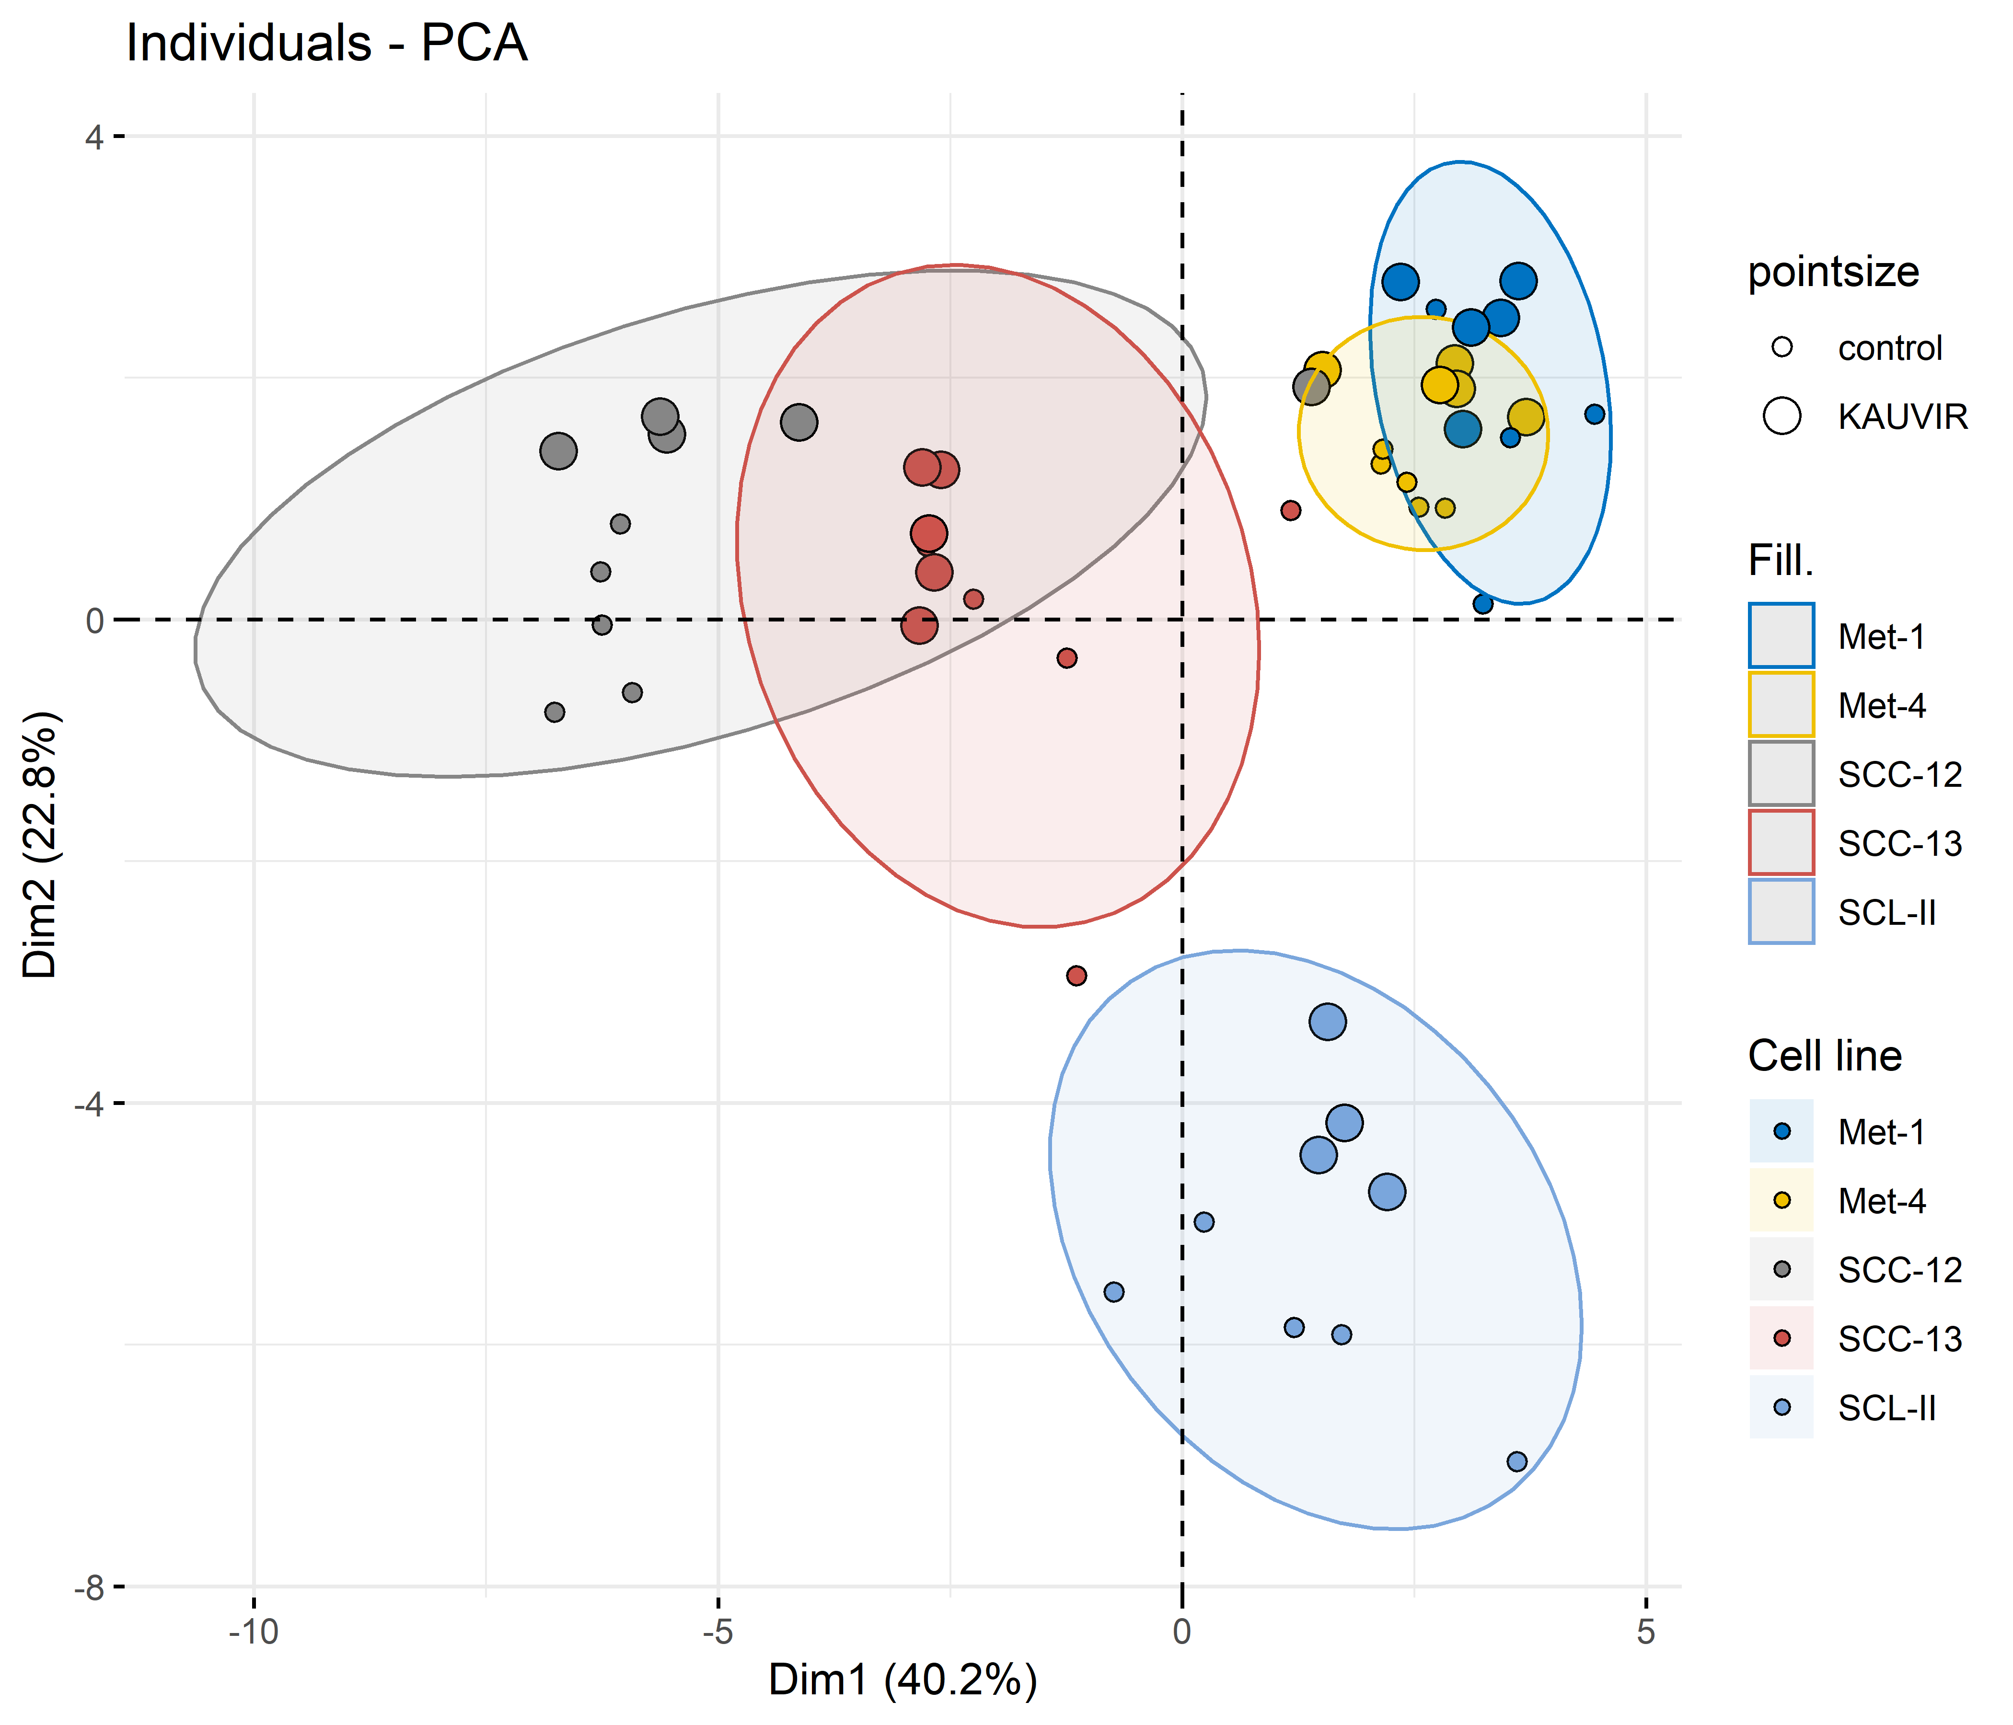
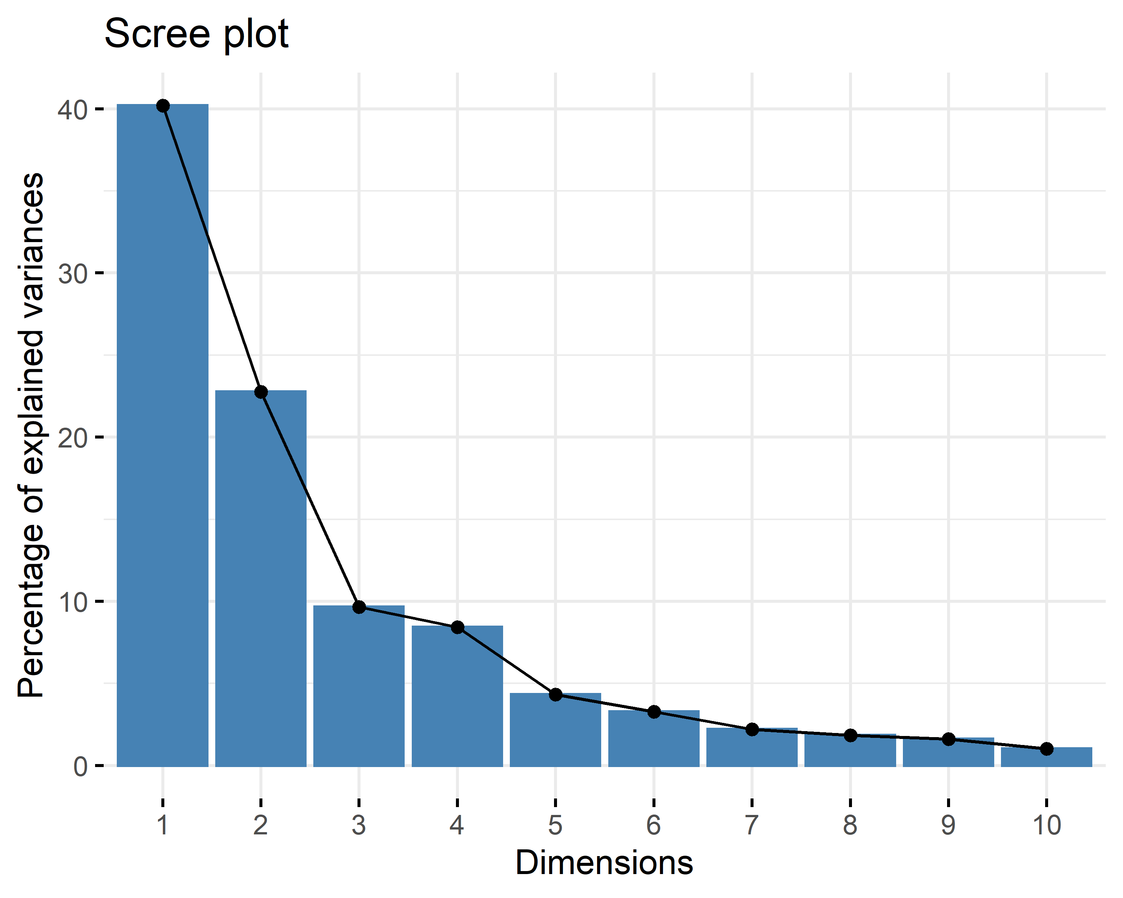
A
B
C
Irradiation
D

Slide 2
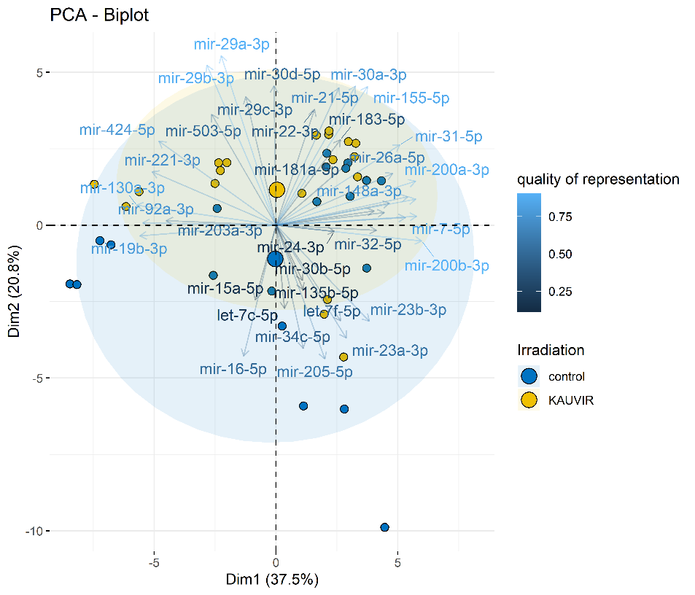
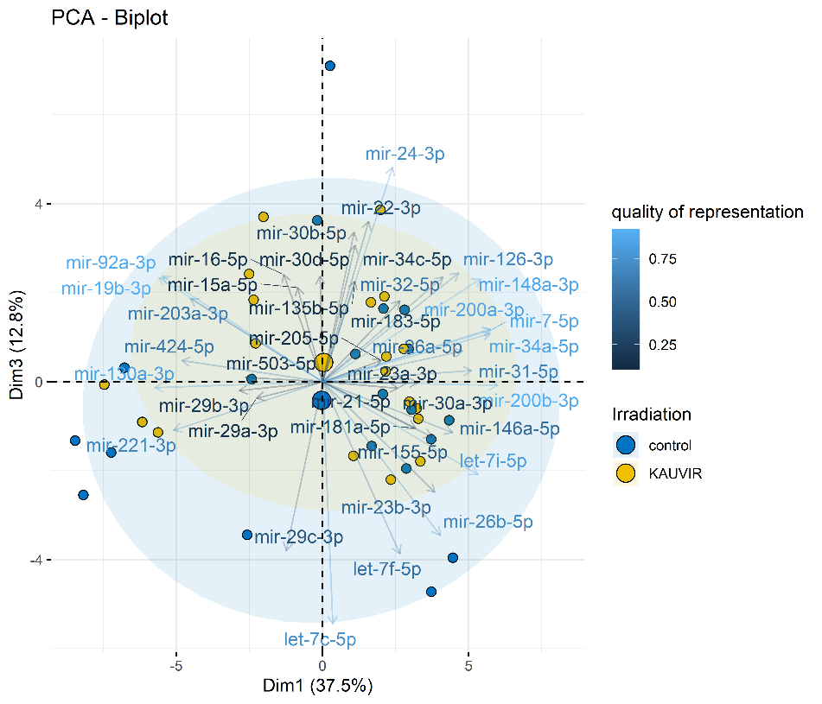
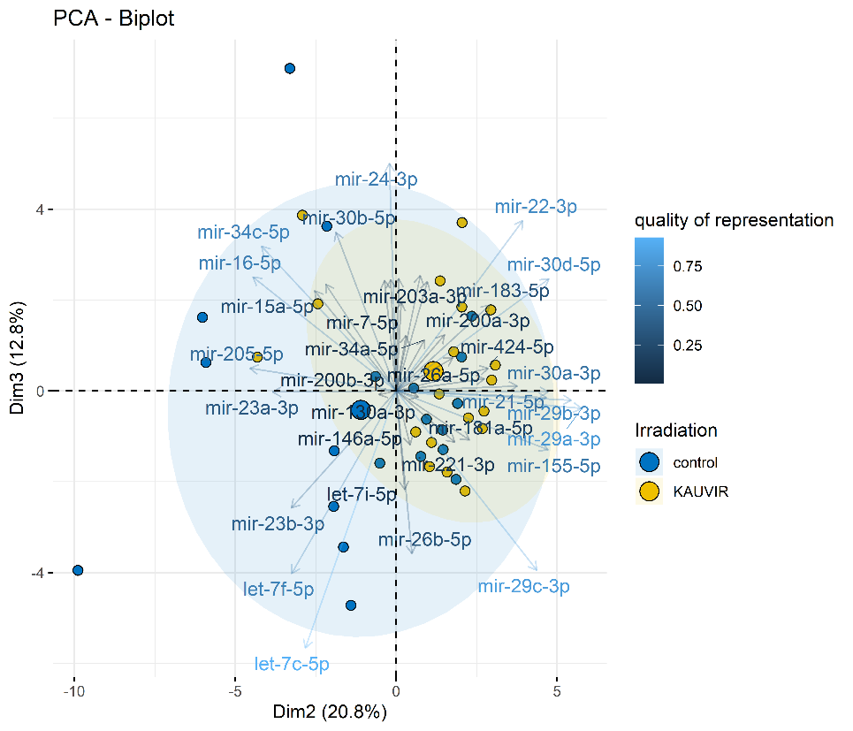
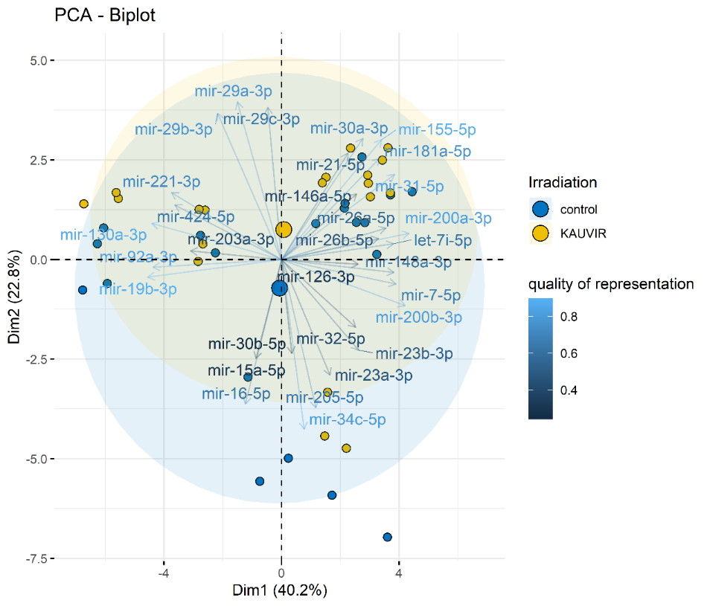
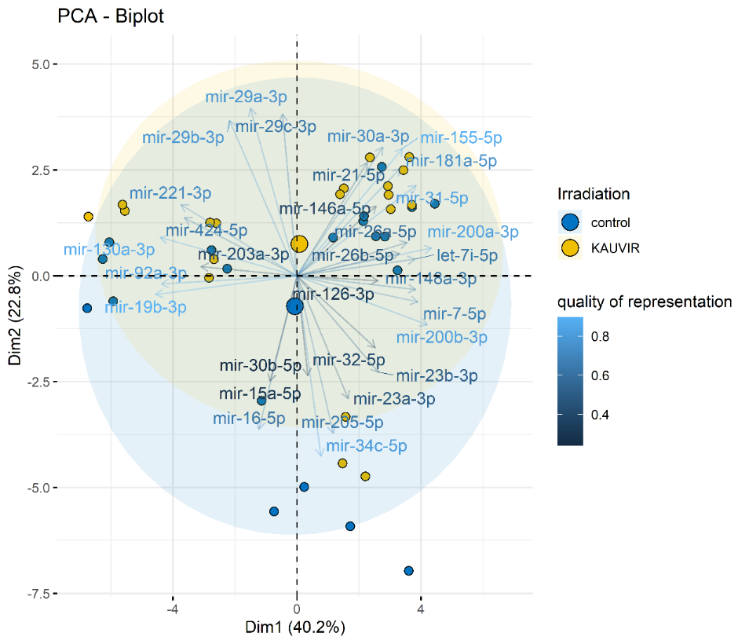
A
B
C

Slide 3
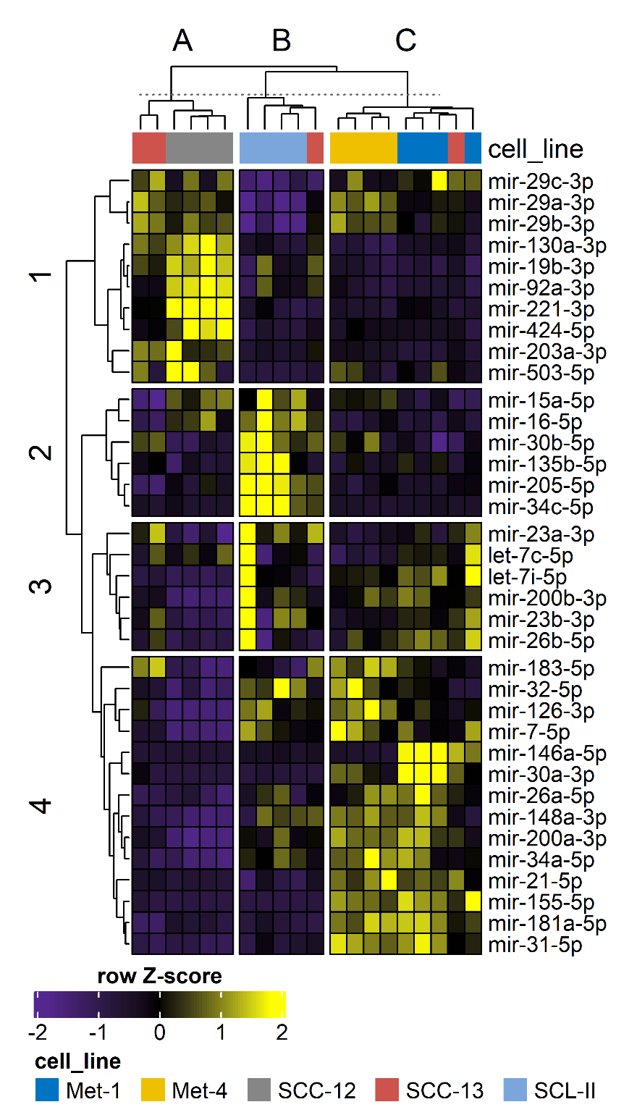
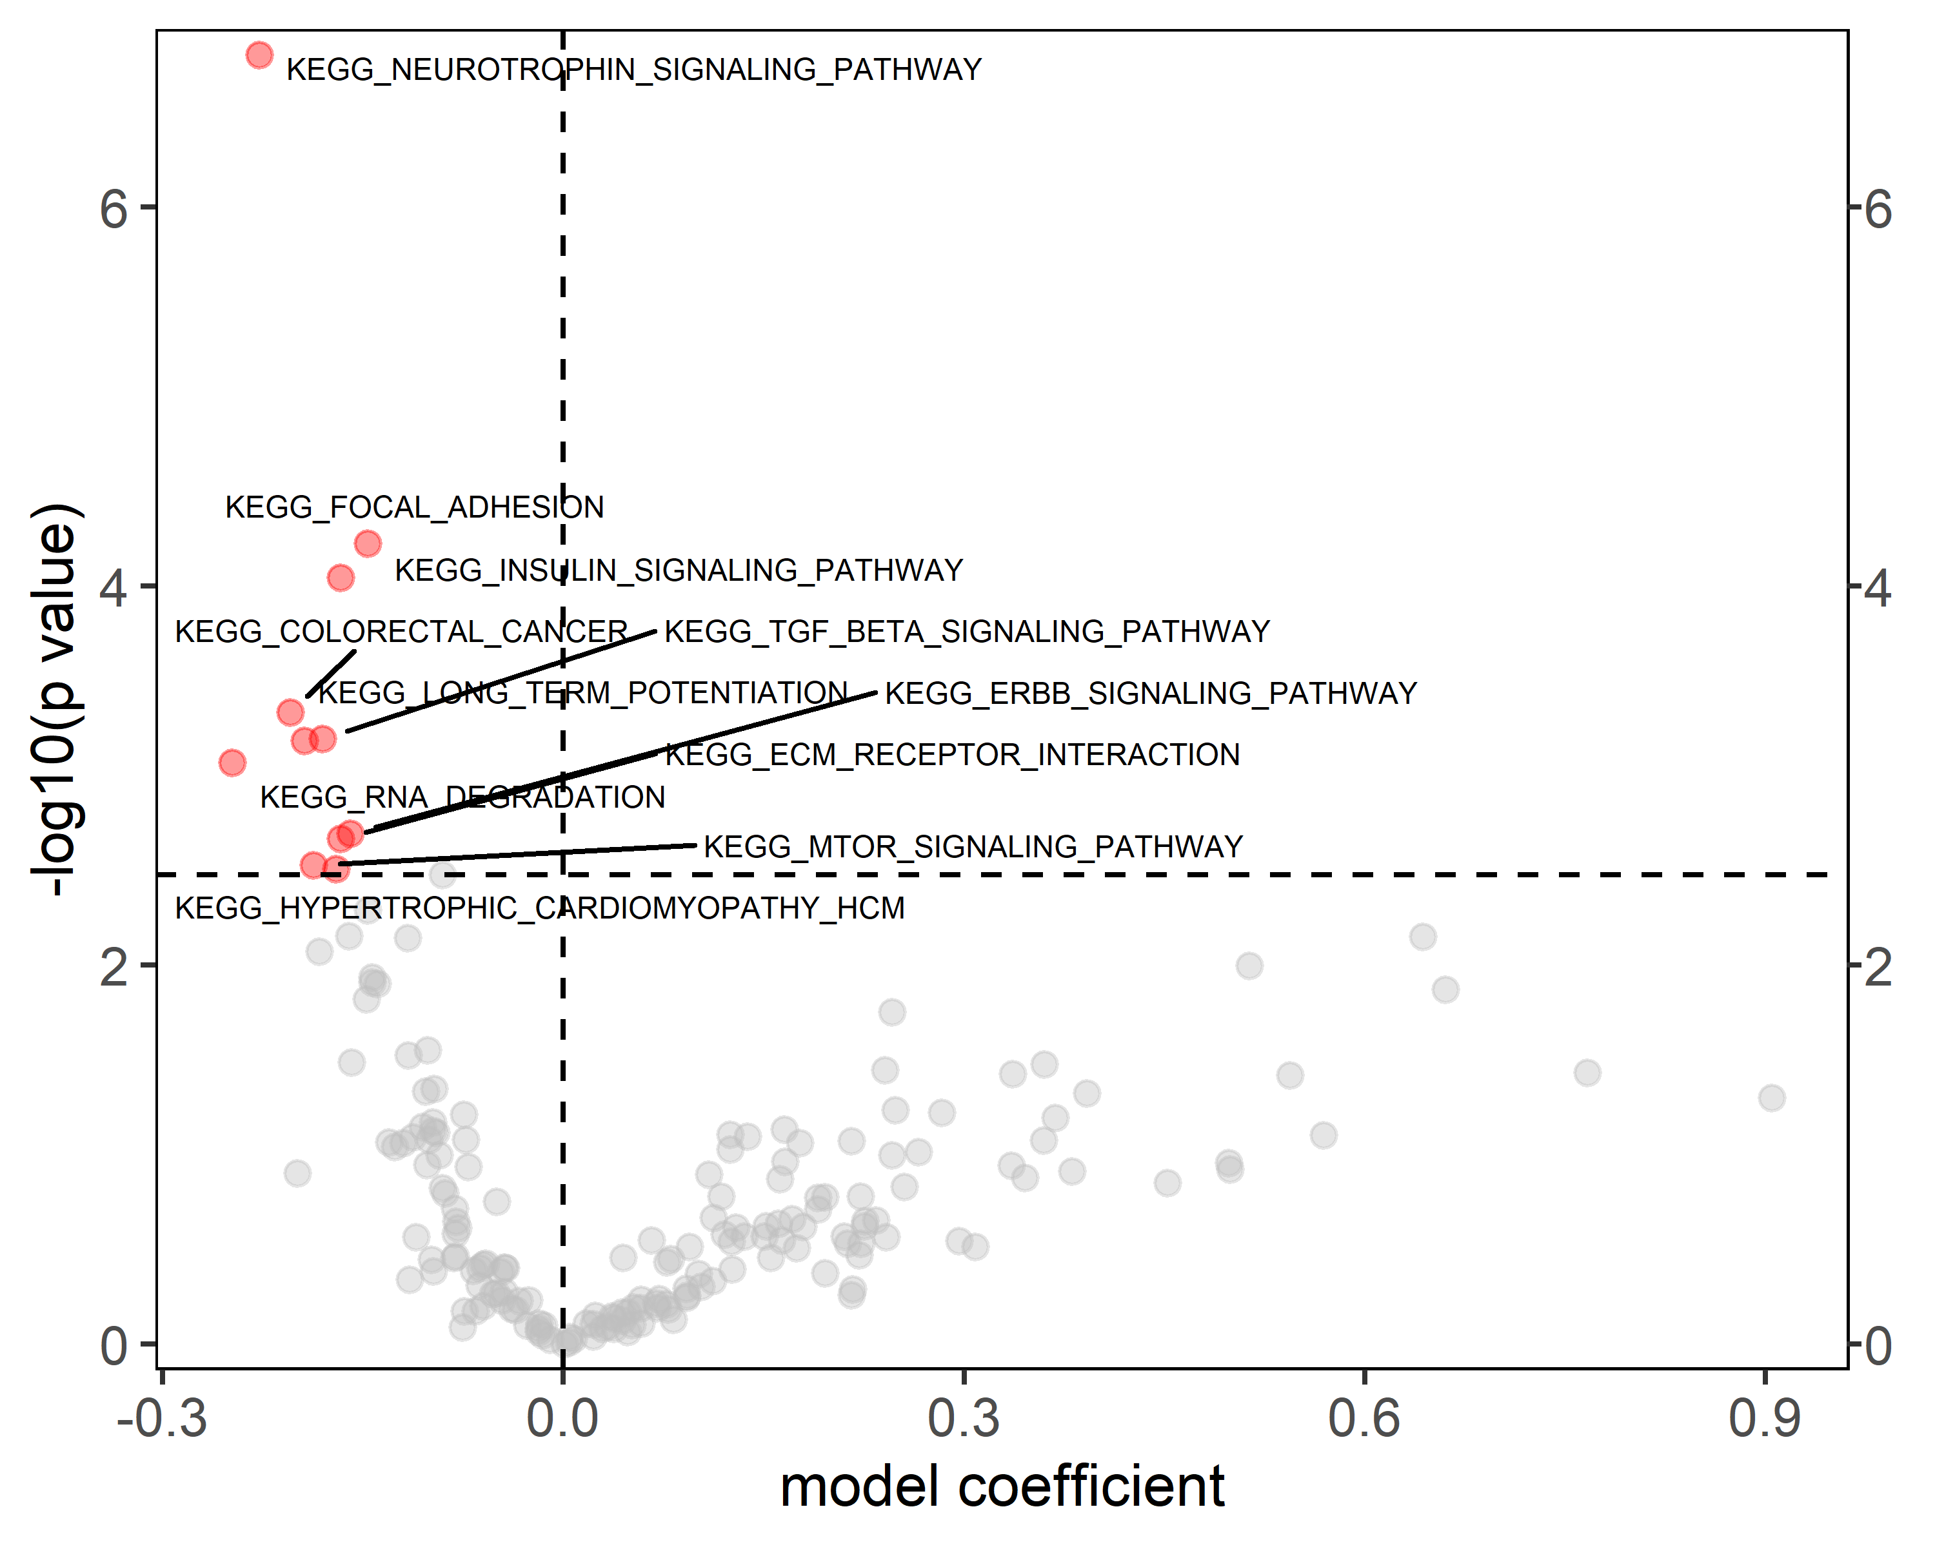
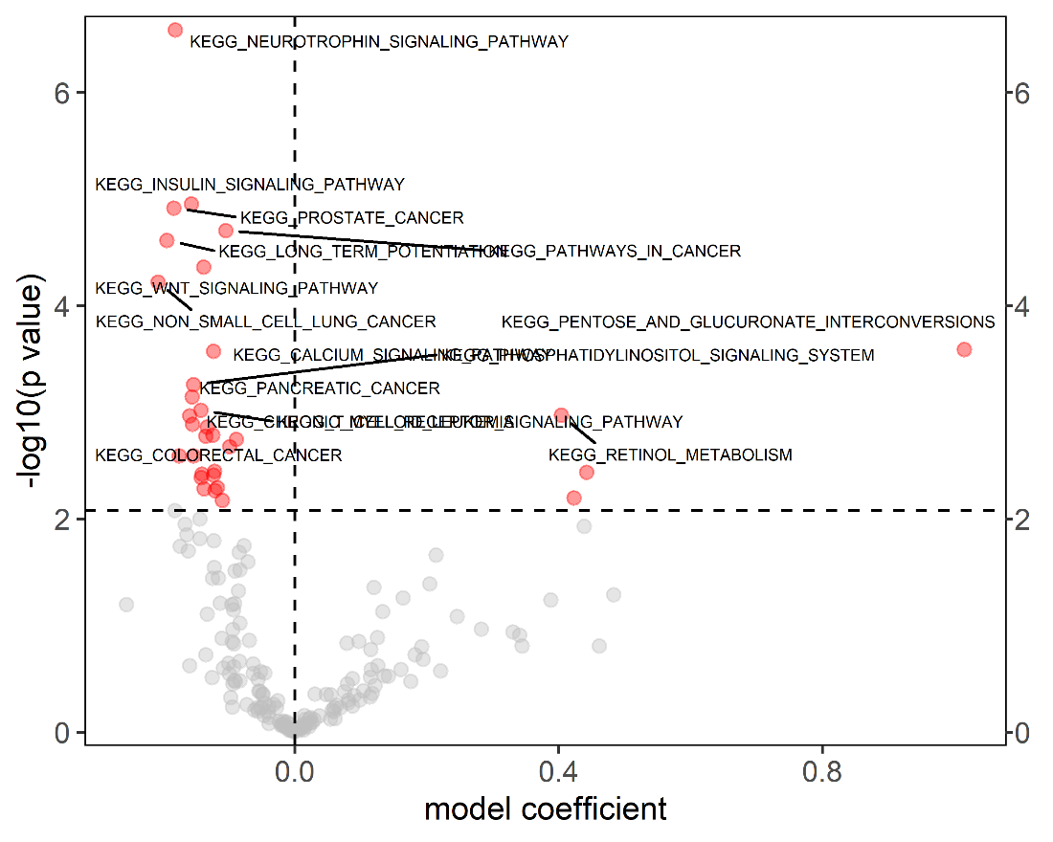
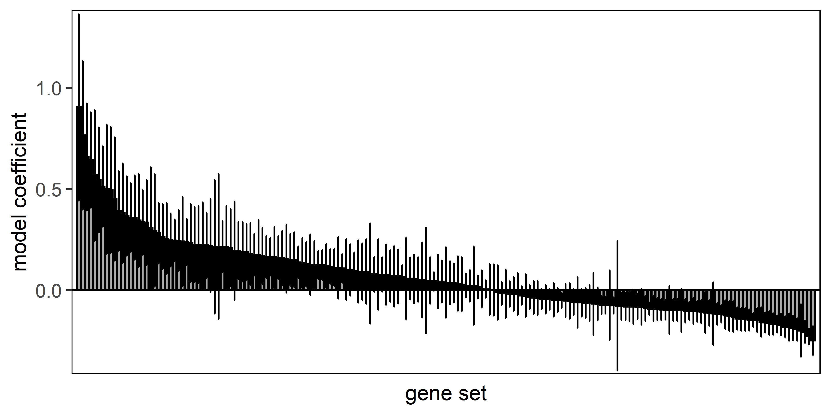
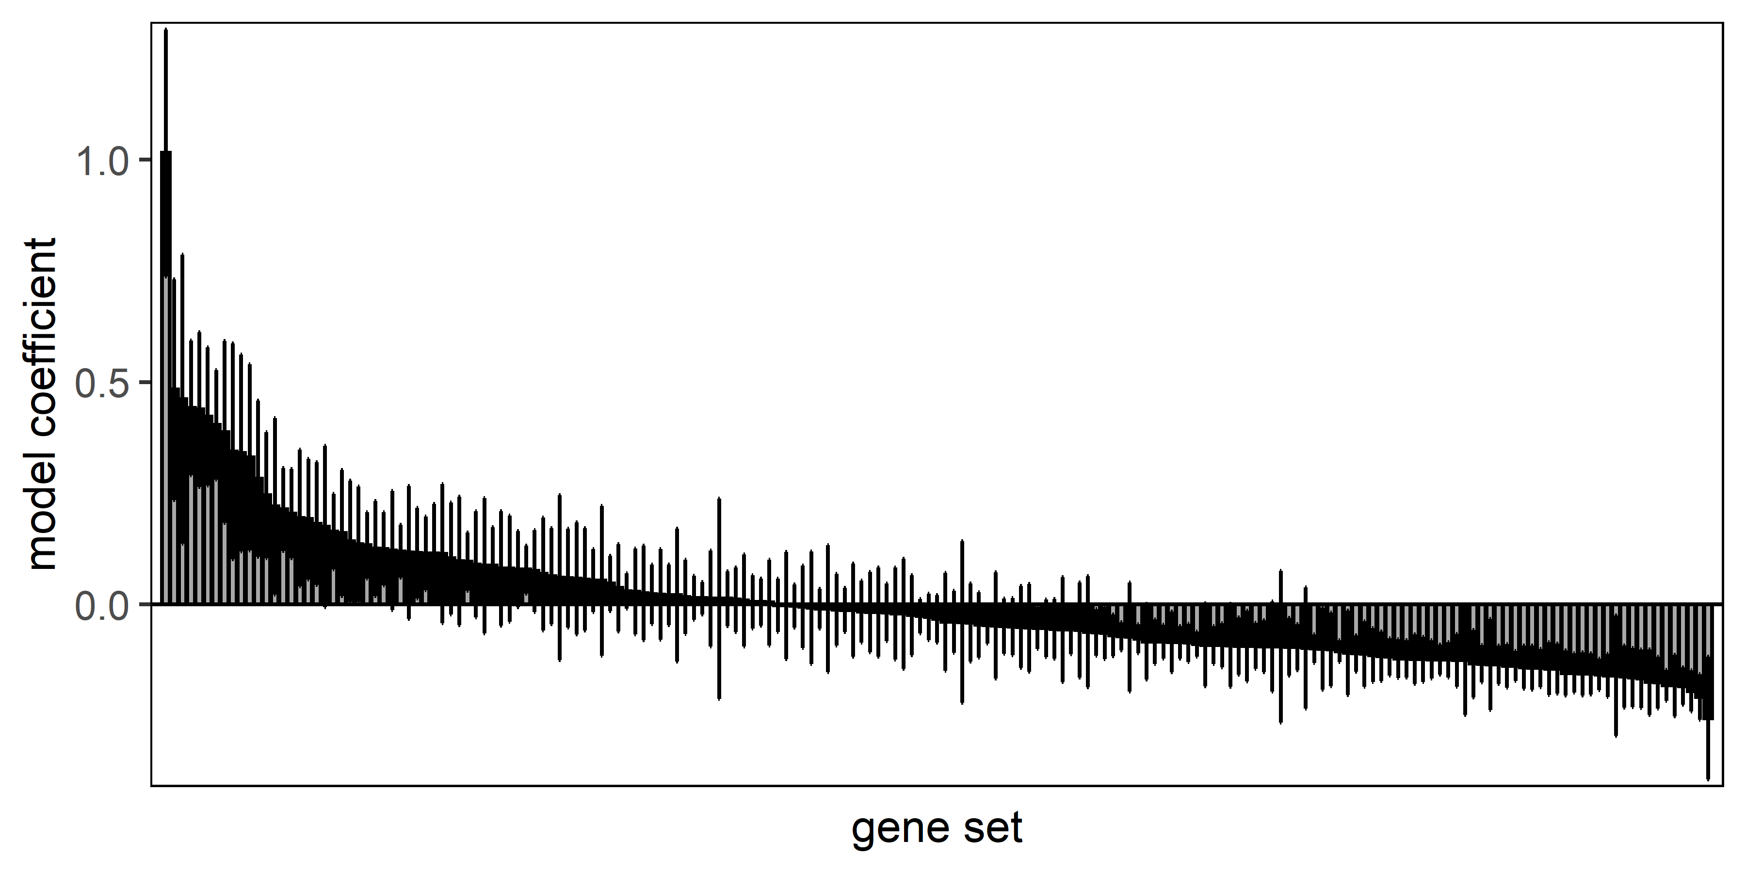
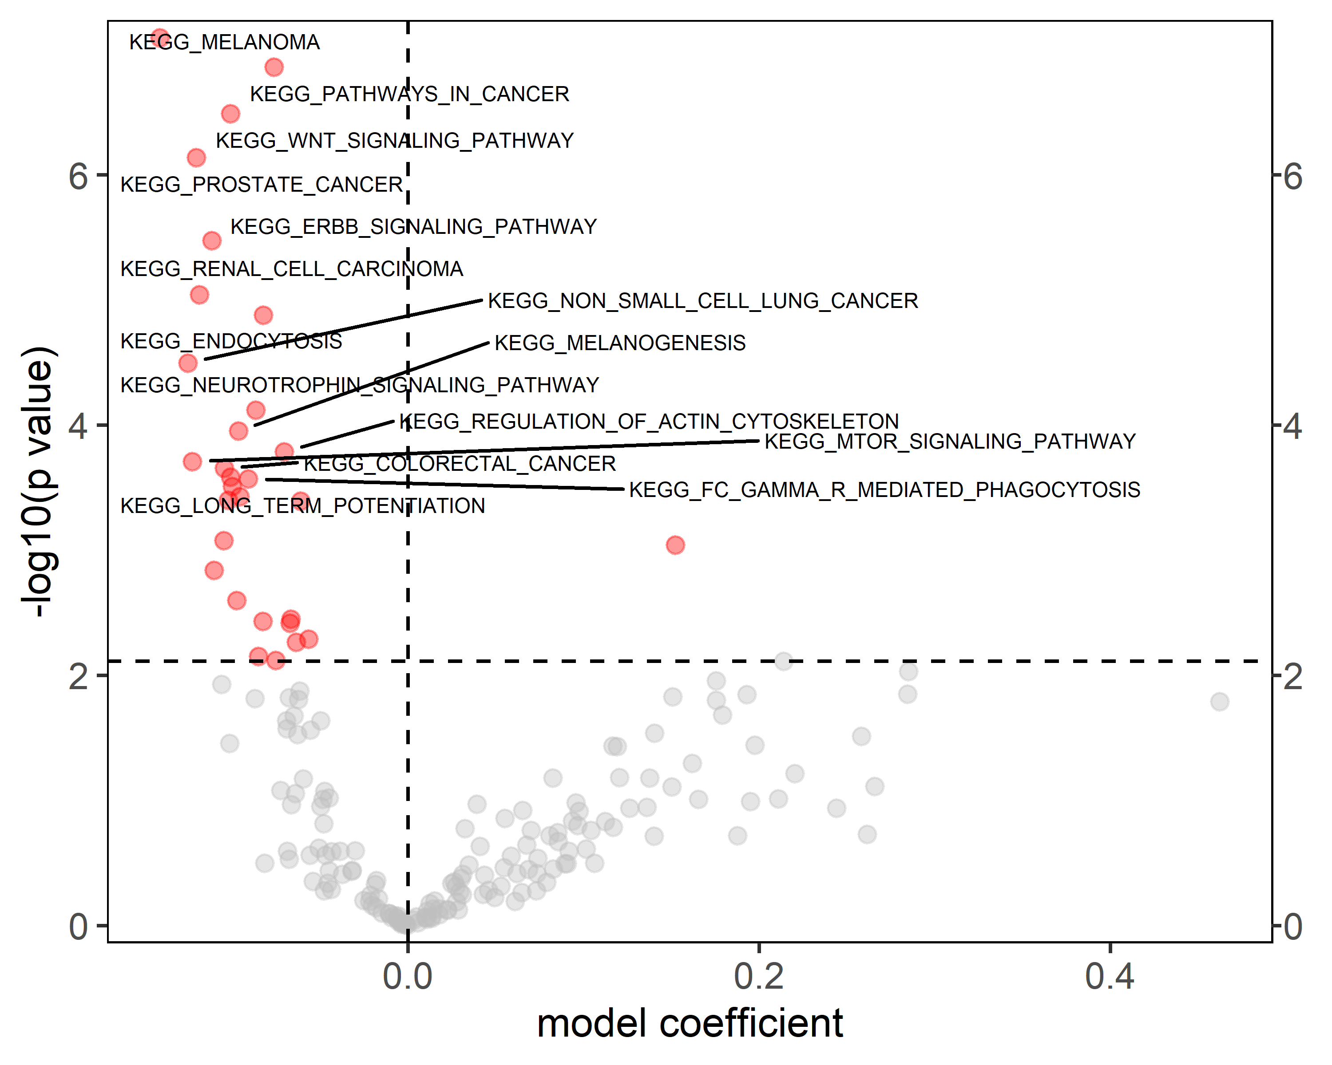
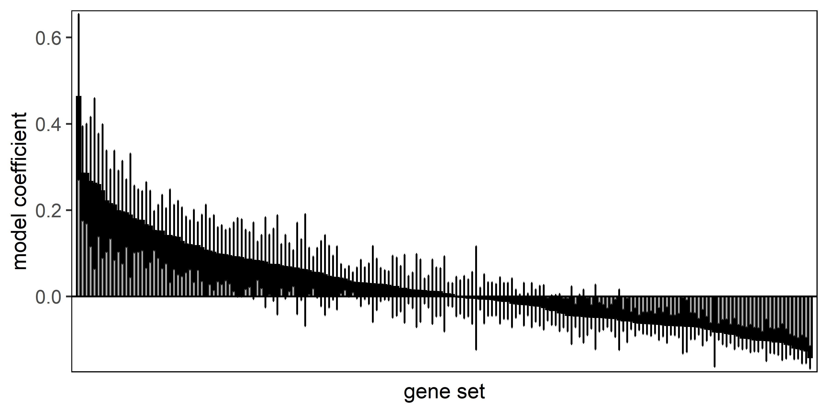
A
B
C
D
B: Cluster 1A
C: Cluster 2B
D: Cluster 4C

Slide 4
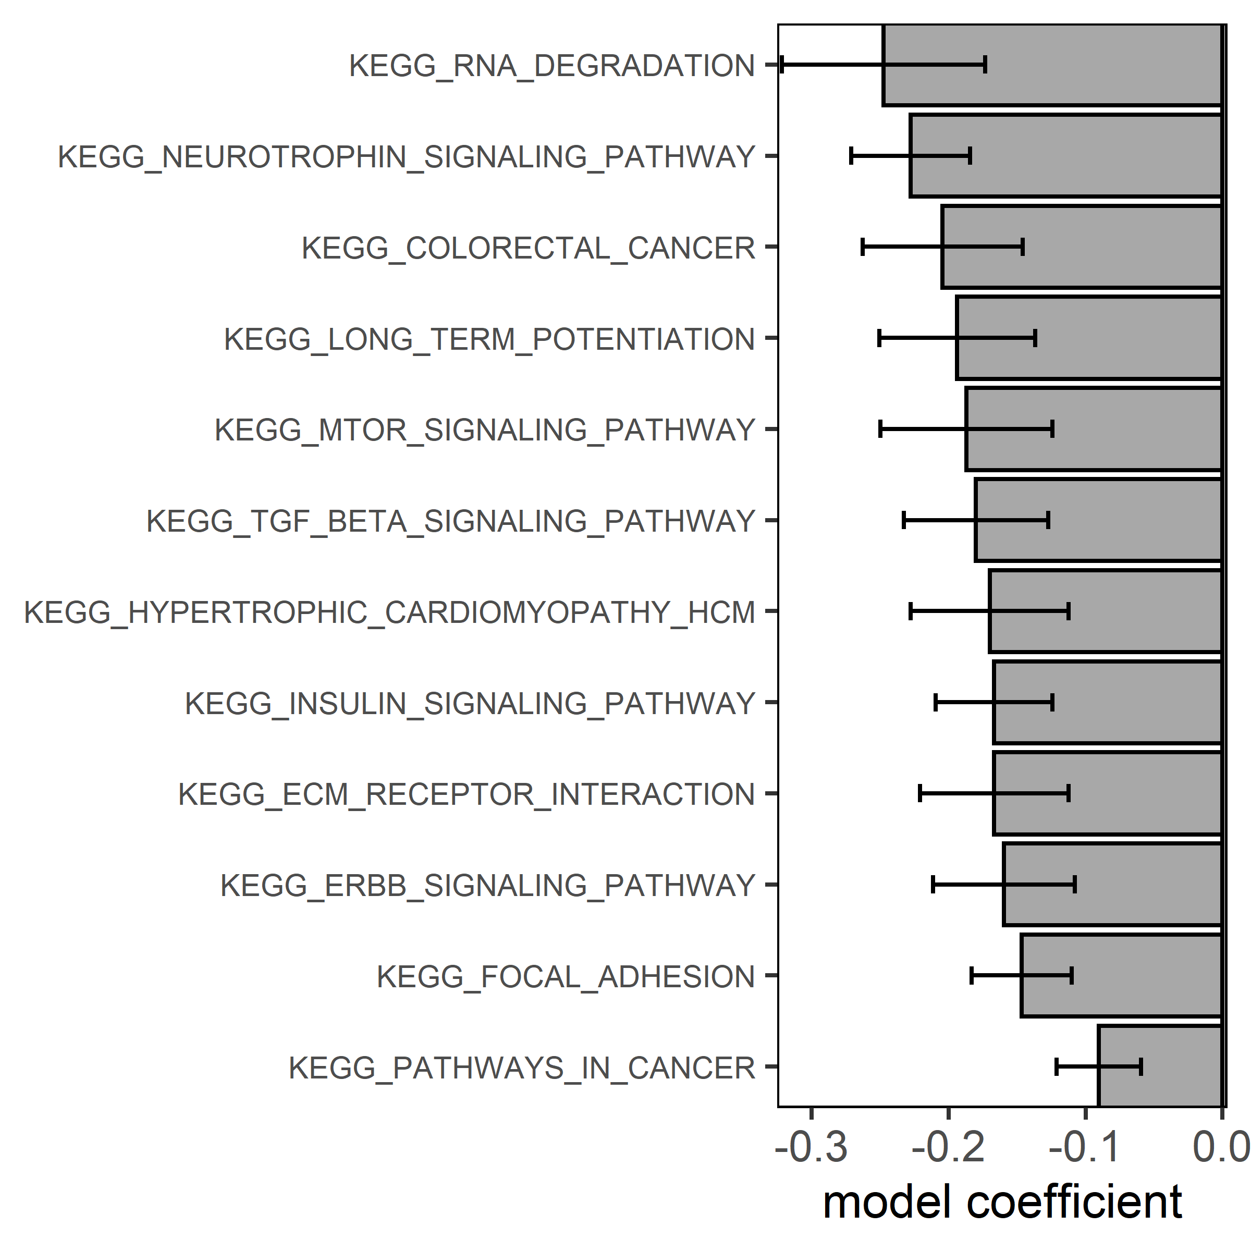
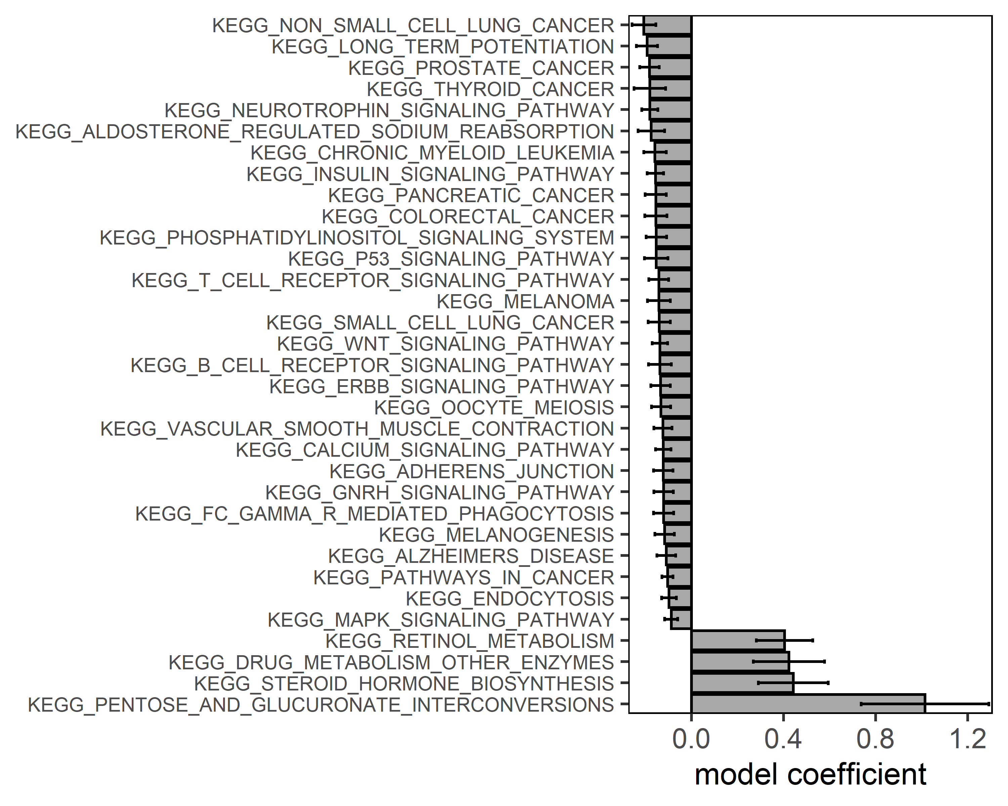
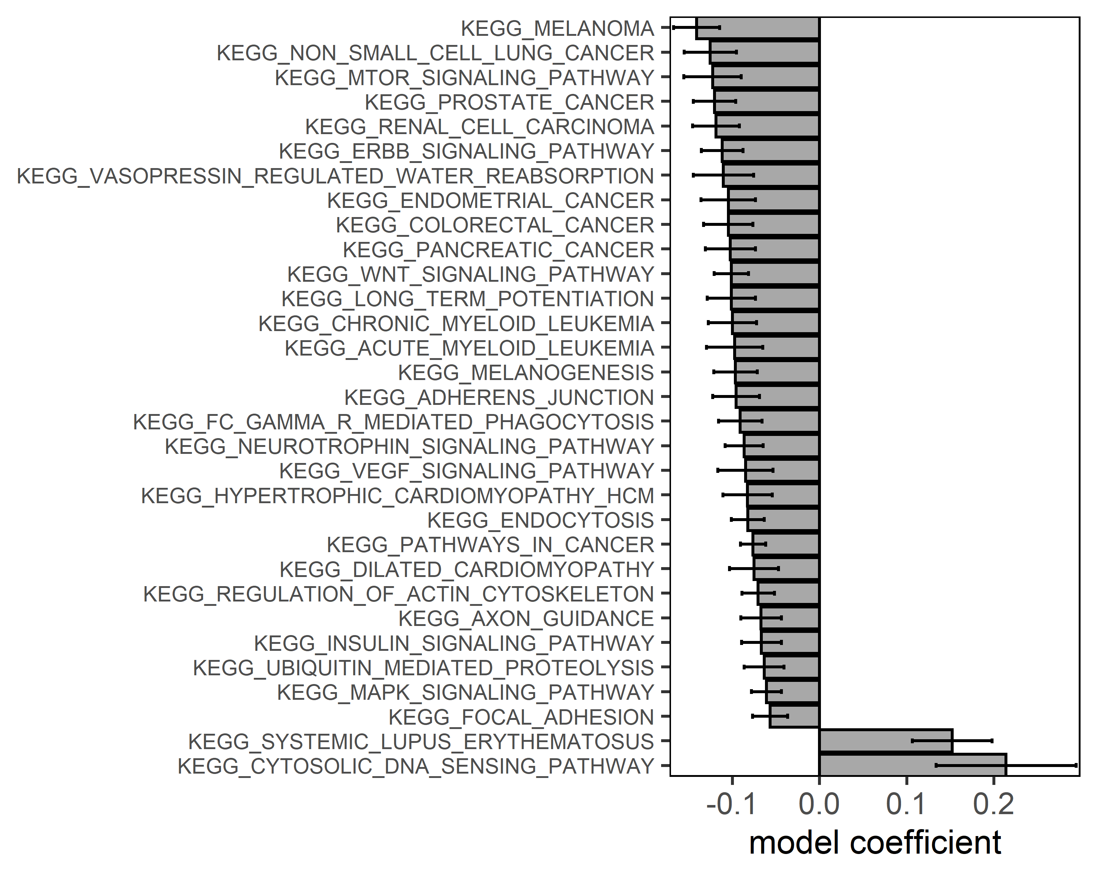
Alternative zur Folie davor

Slide 5
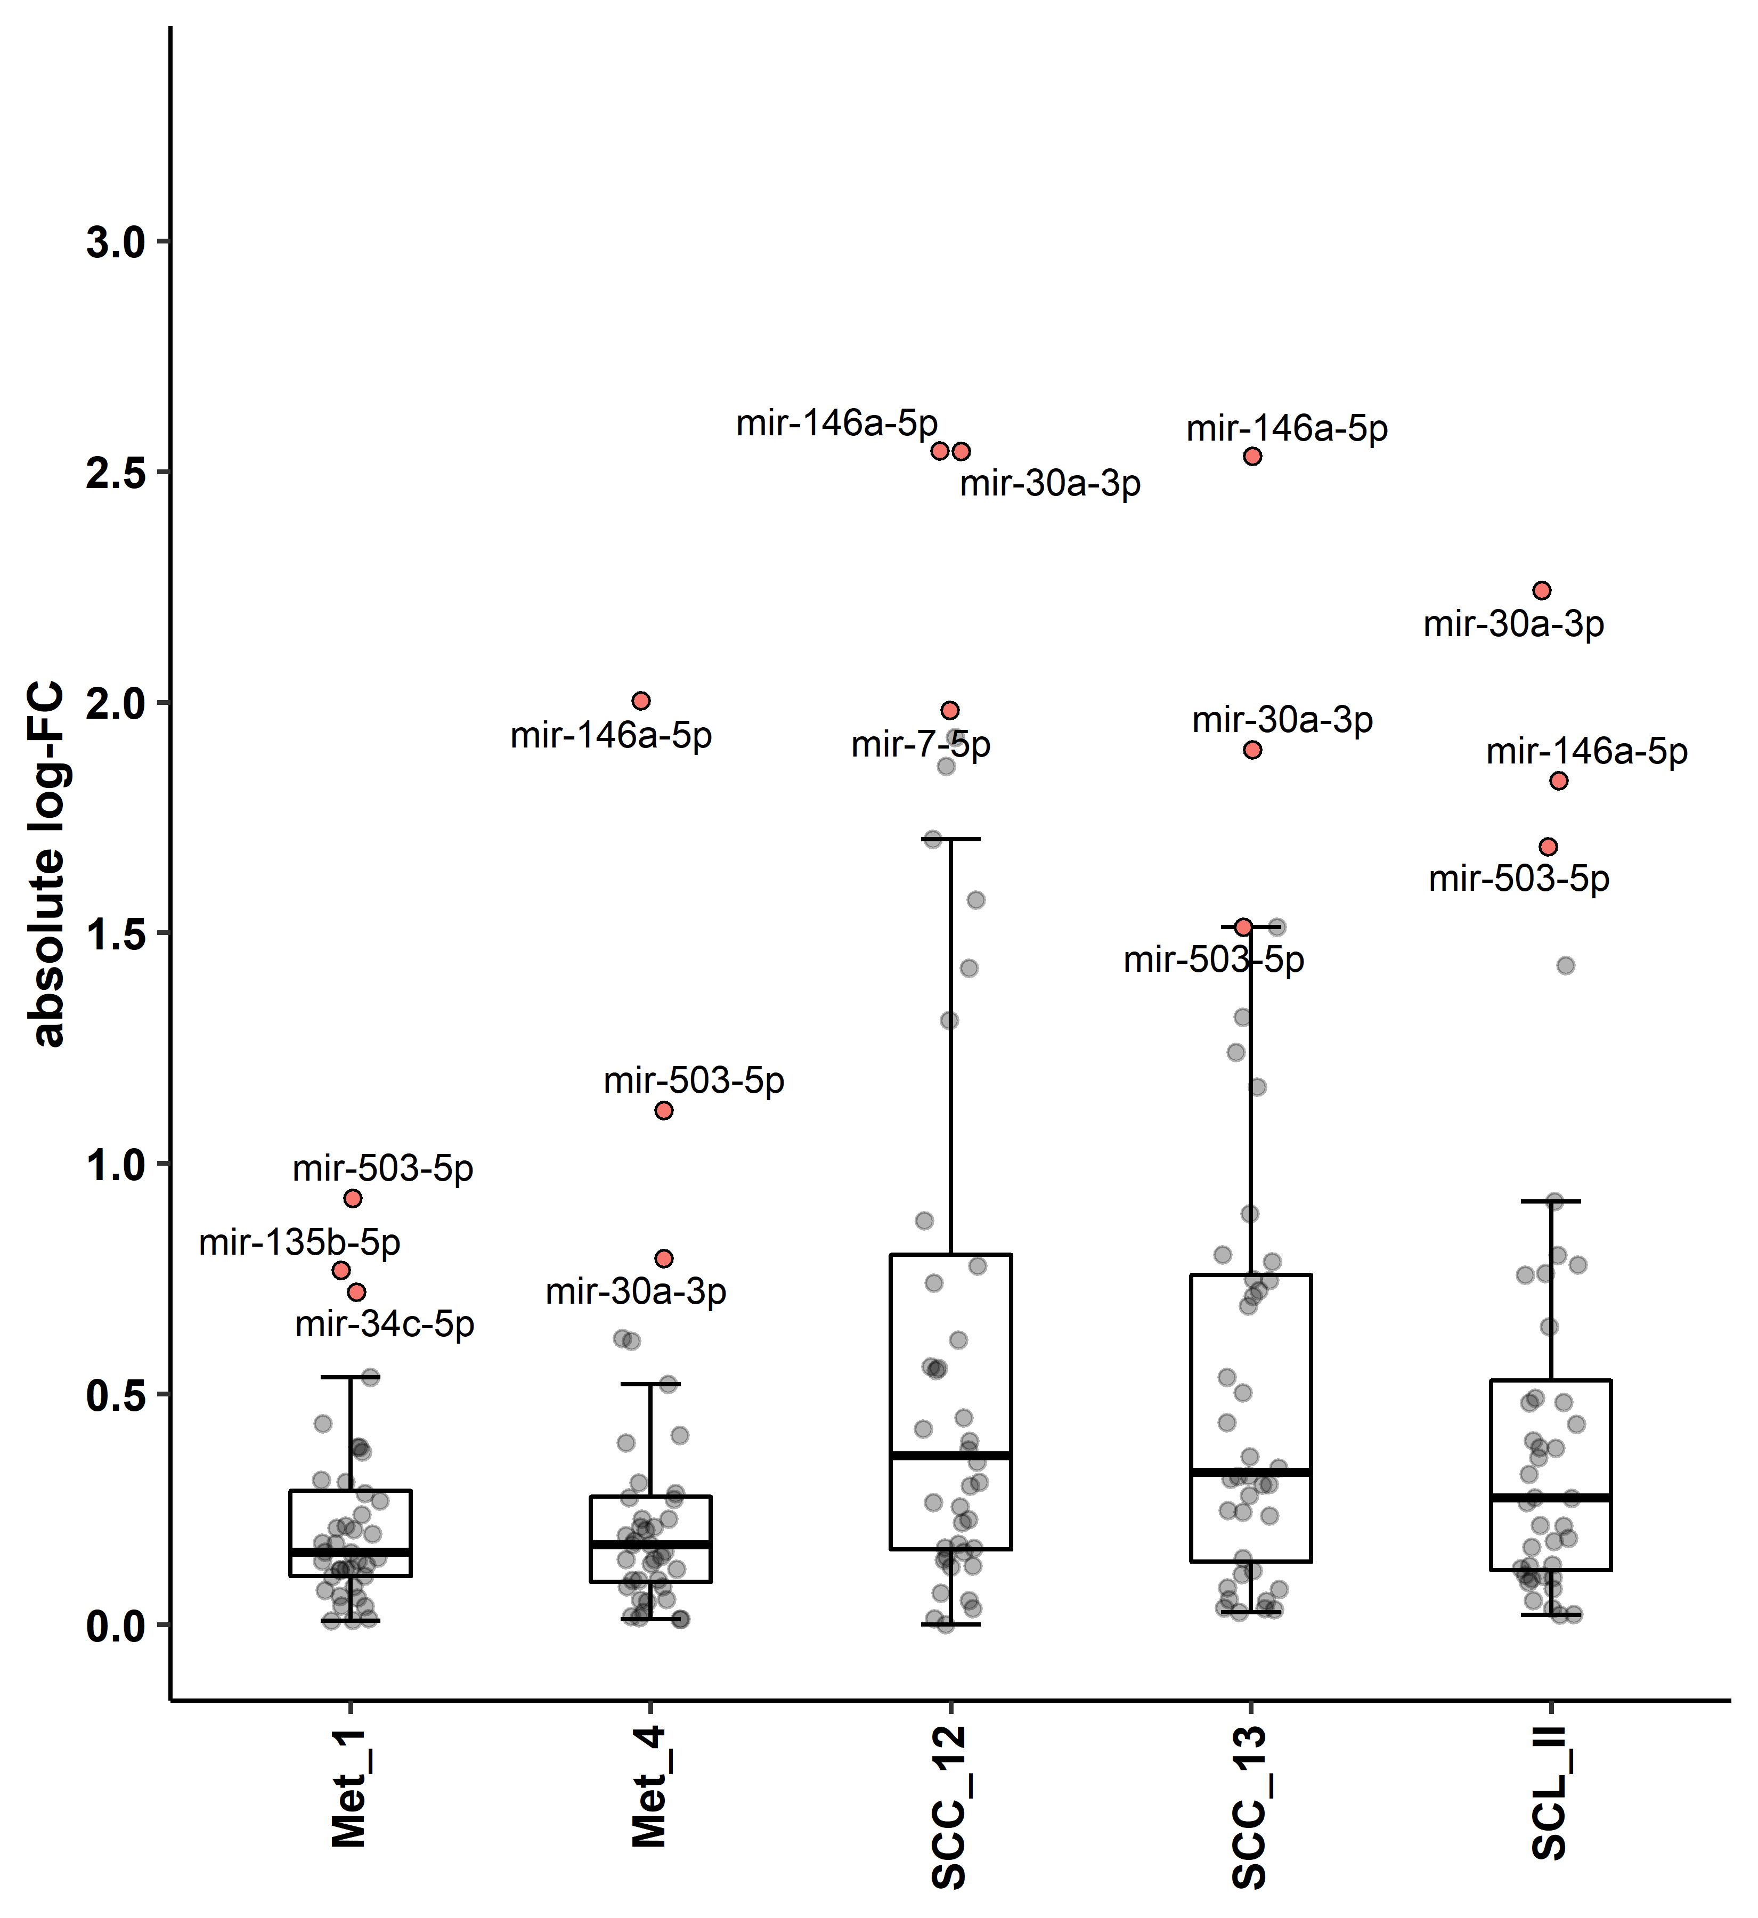
Kruskal-Wallis, $H_{4}$ = 18.6, p = 0.000927

Slide 6
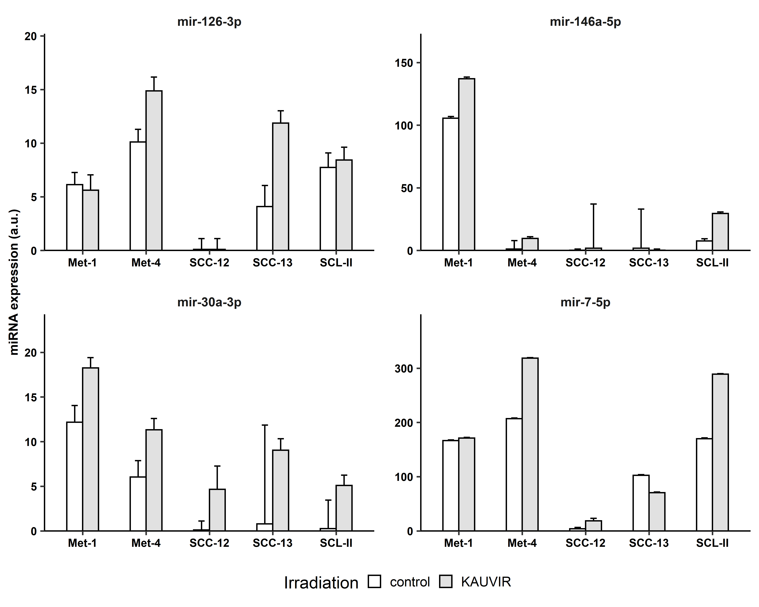
Anova, $F_{4, 29}$ = 3.51, p = 0.019
Anova, $F_{4, 29}$ = 3.37, p = 0.022
*
*
Anova, $F_{4, 29}$ = 3.70, p = 0.015
Anova, $F_{4, 29}$ = 4.56, p = 0.006
*
*
***

Slide 7
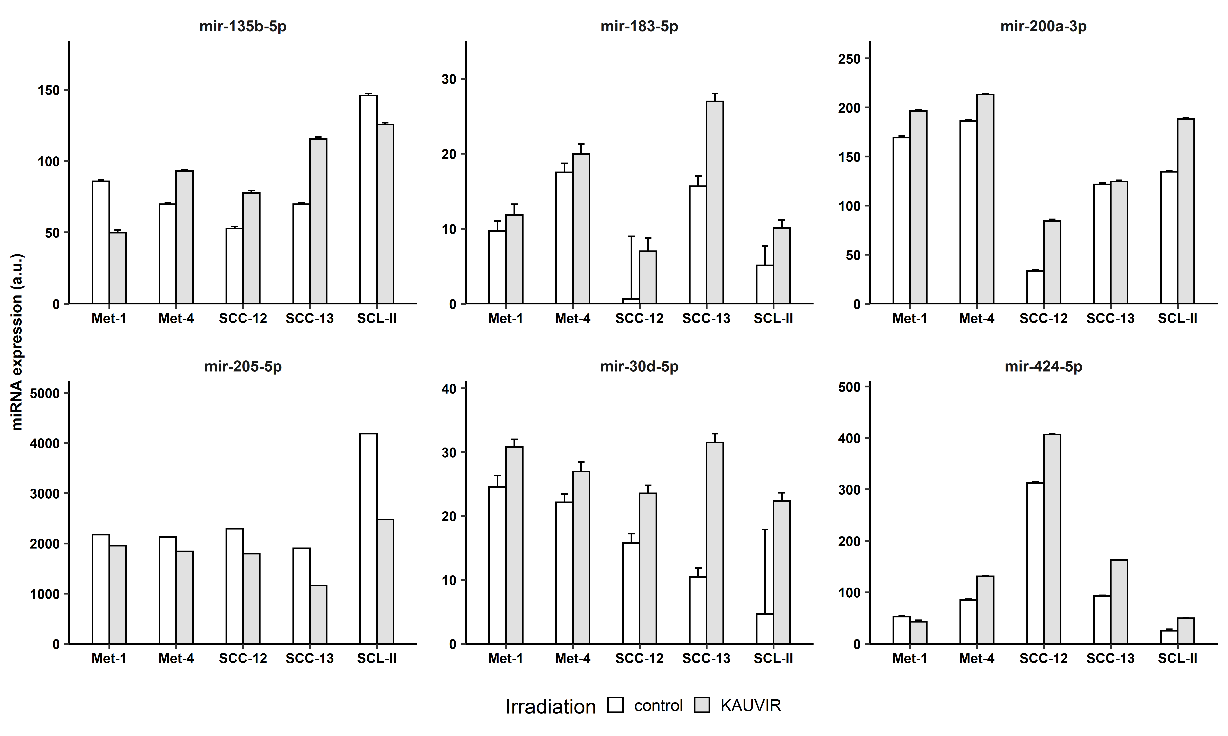
Anova, $F_{1, 29}$ = 5.81, p = 0.0468
Anova, $F_{1, 29}$ = 11.0, p = 0.0054
Anova, $F_{1, 29}$ = 9.88, p = 0.0104
*
*
*
Anova, $F_{1, 29}$ = 21.2, p = 0.000253
Anova, $F_{1, 29}$ = 14.3, p = 0.00212
Anova, $F_{1, 29}$ = 14.3, p = 0.00279
**
**
*

Slide 8
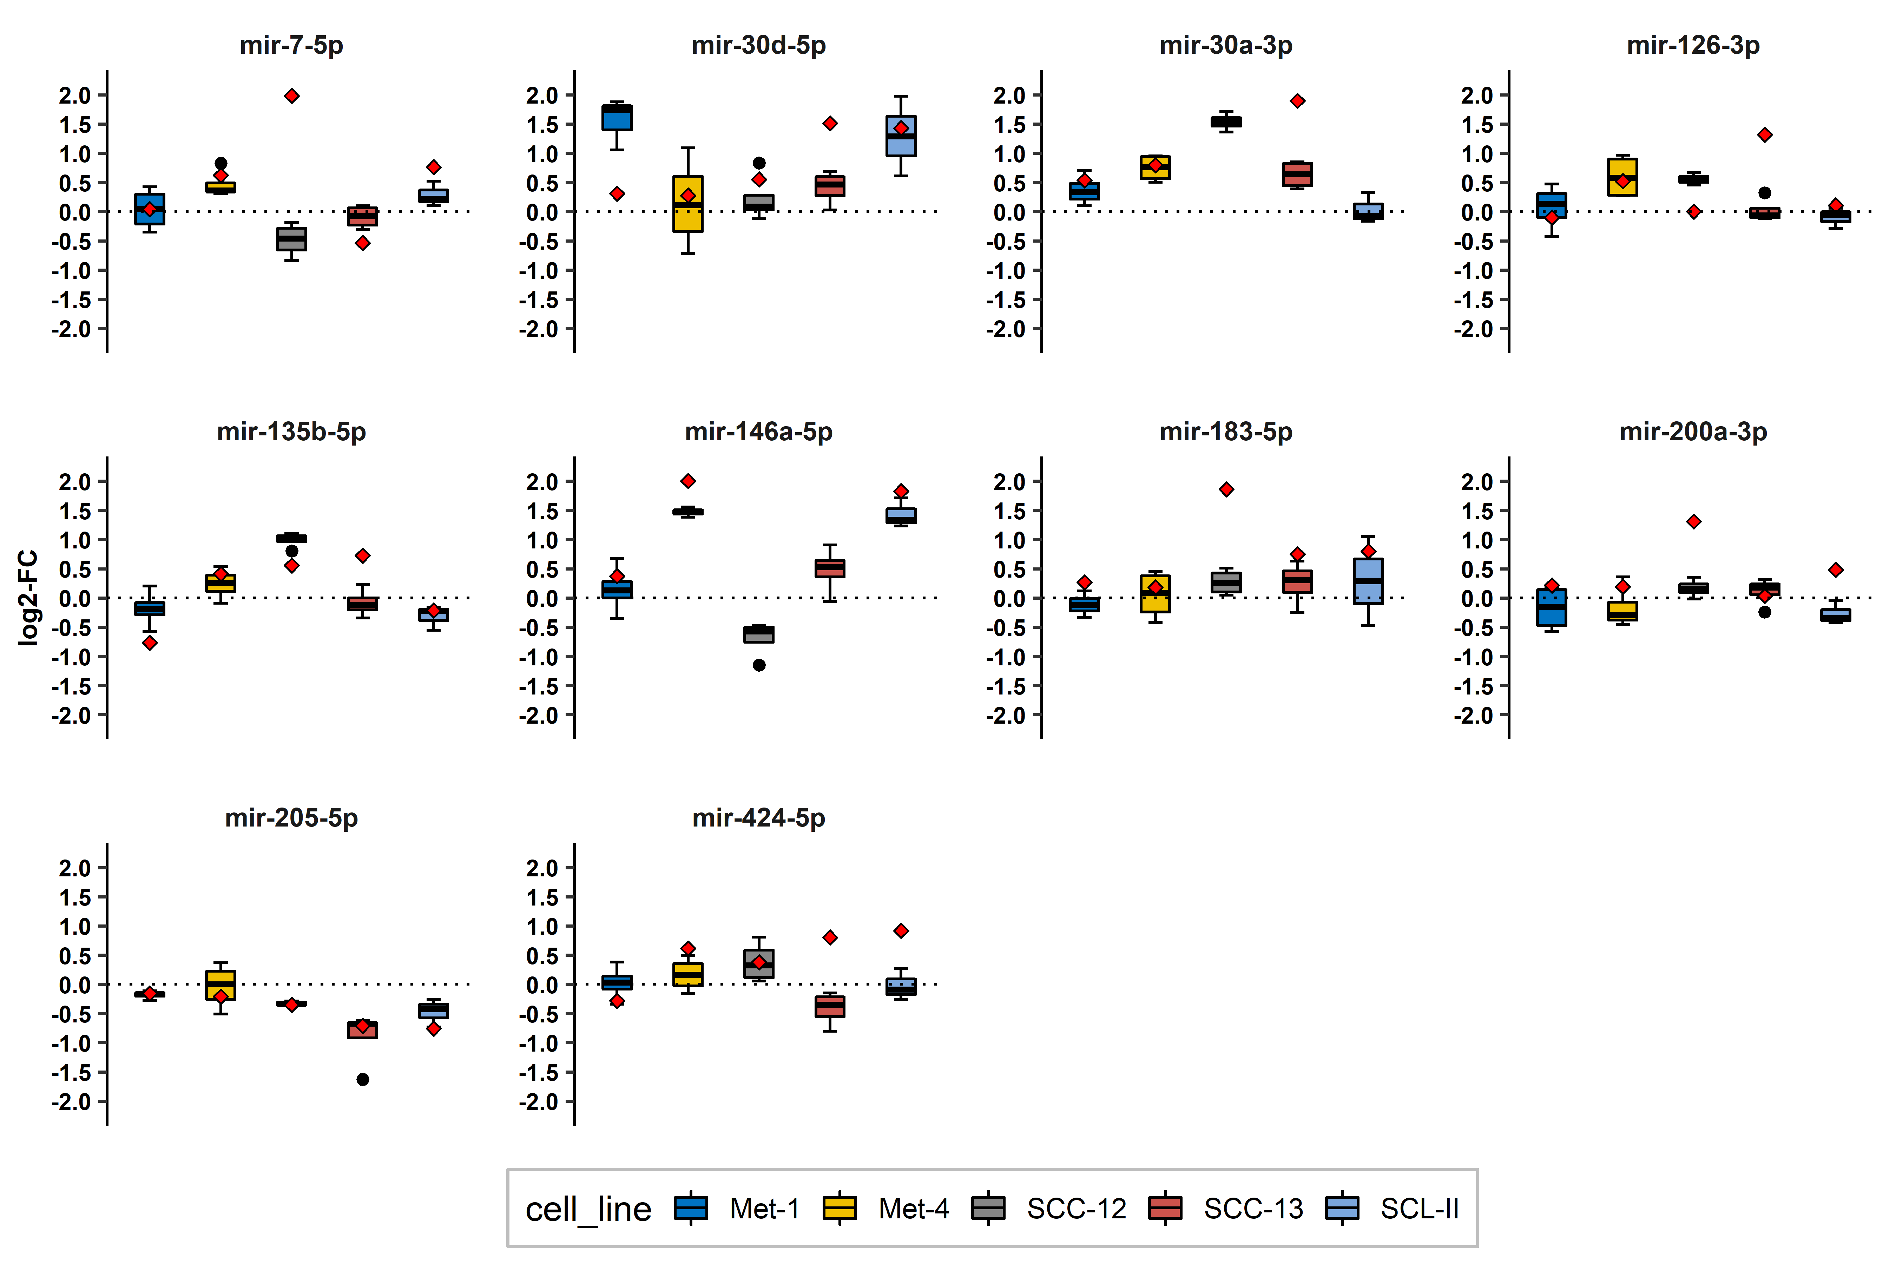
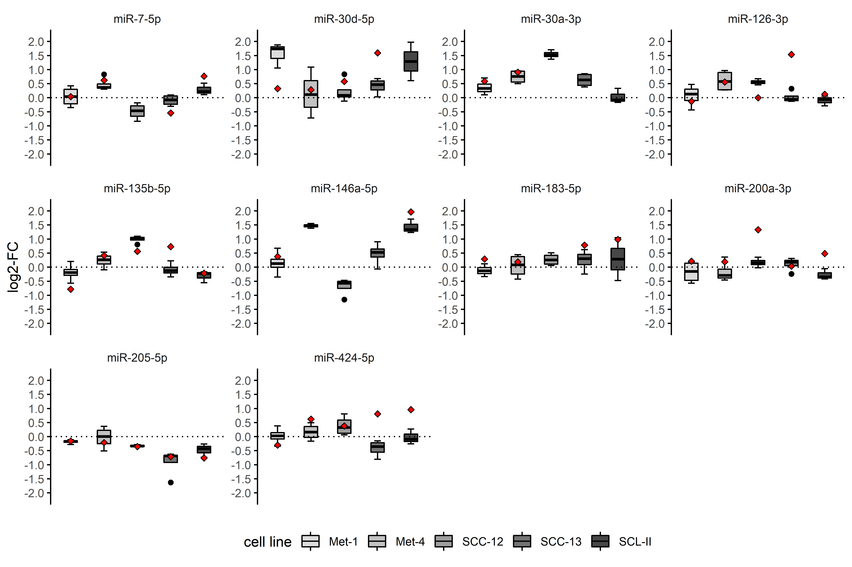
*
***
*
**
*
*
*
*
****
*
***
*
*
***
*
Fdr-adjustment?
Oder darauf vertrauen, dass zweimal p < 0.05 -> 0.0025 Signifikanzlevel ausreichend?
FirePlex:
|log2-FC| ≤ 2
|log2-FC| > 2

Slide 9
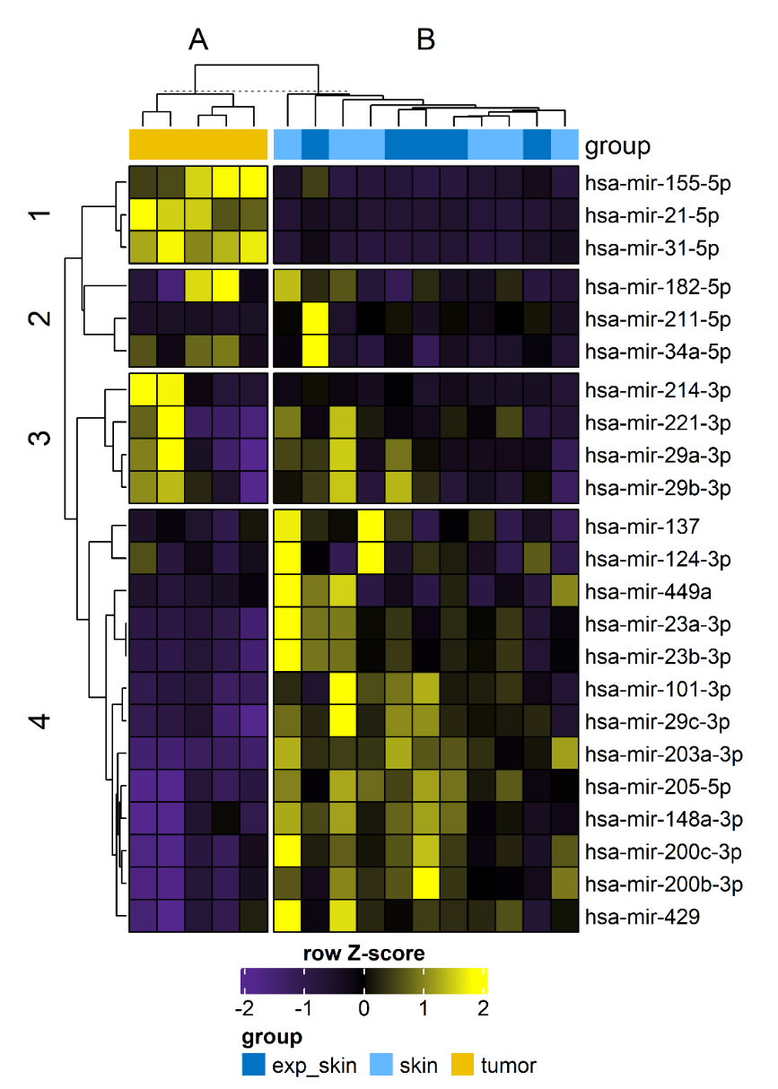
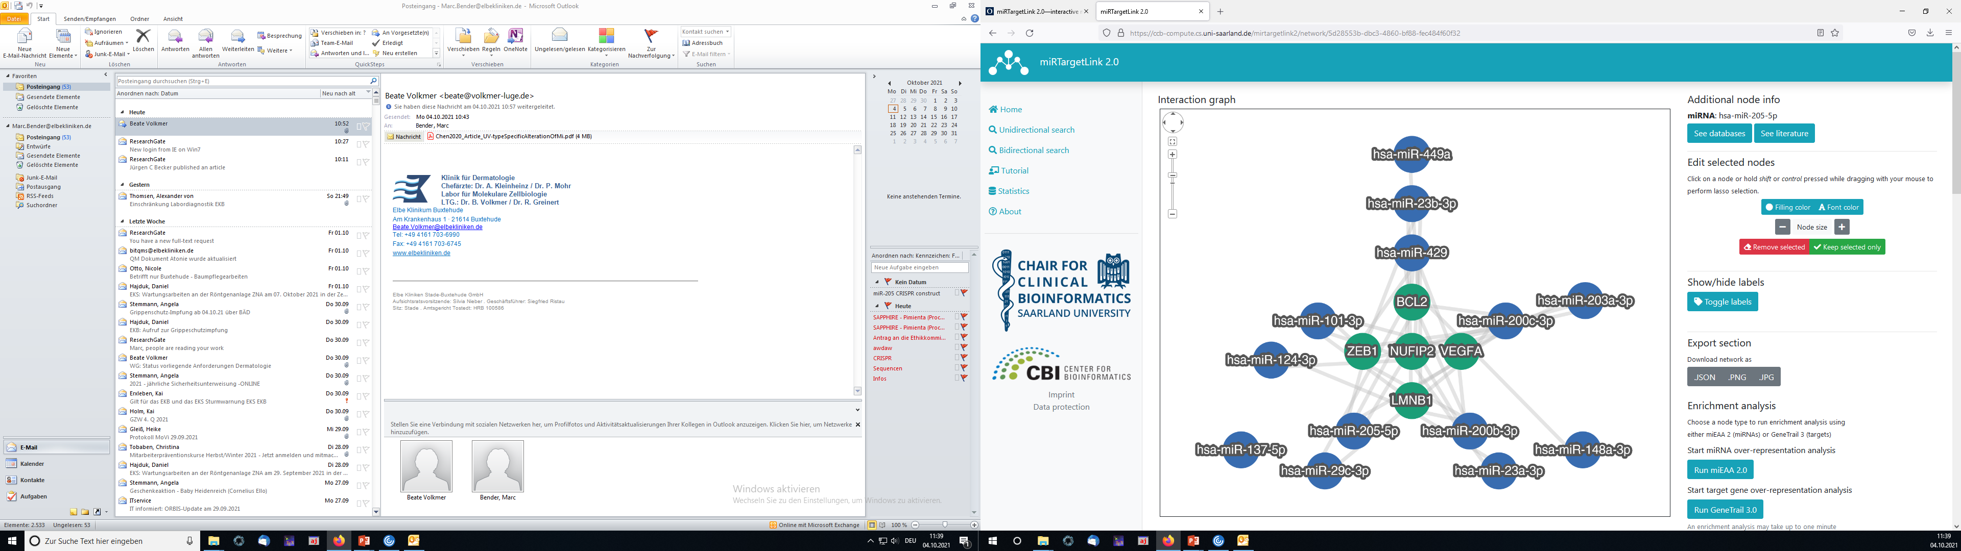
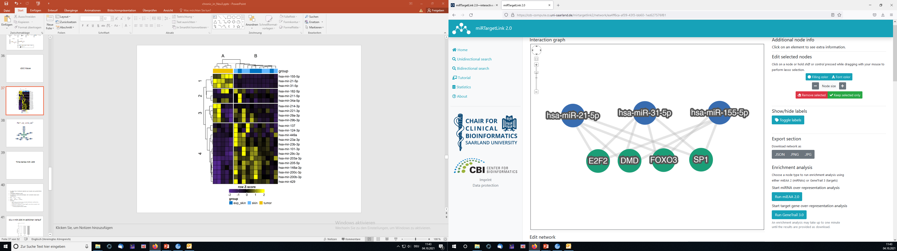
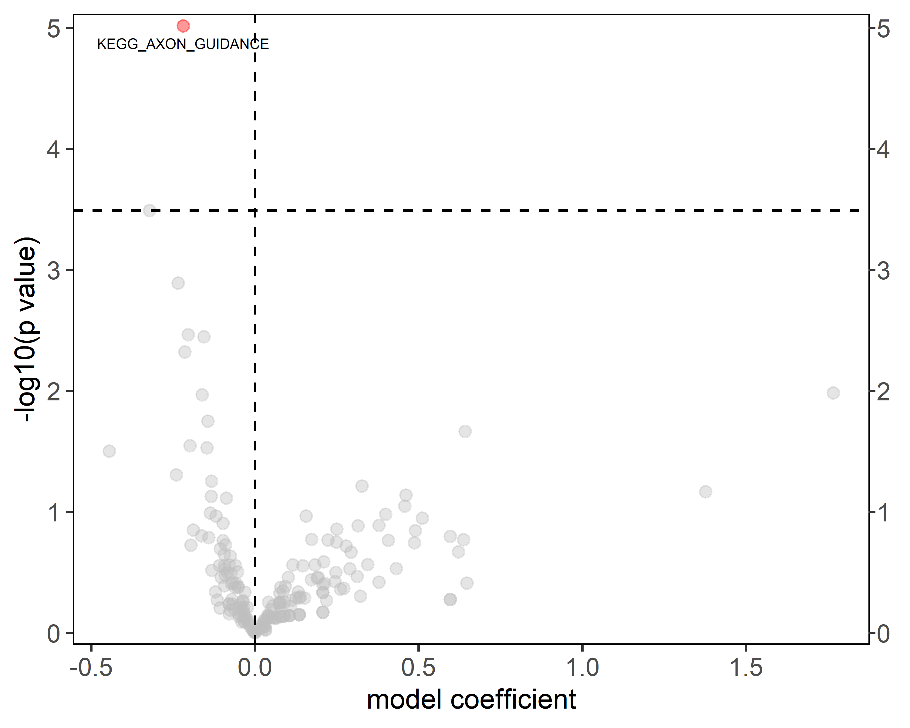
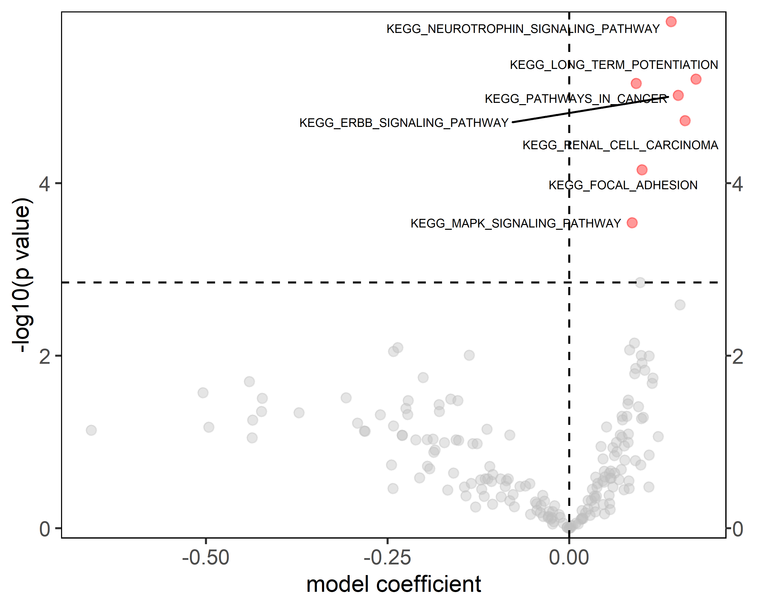
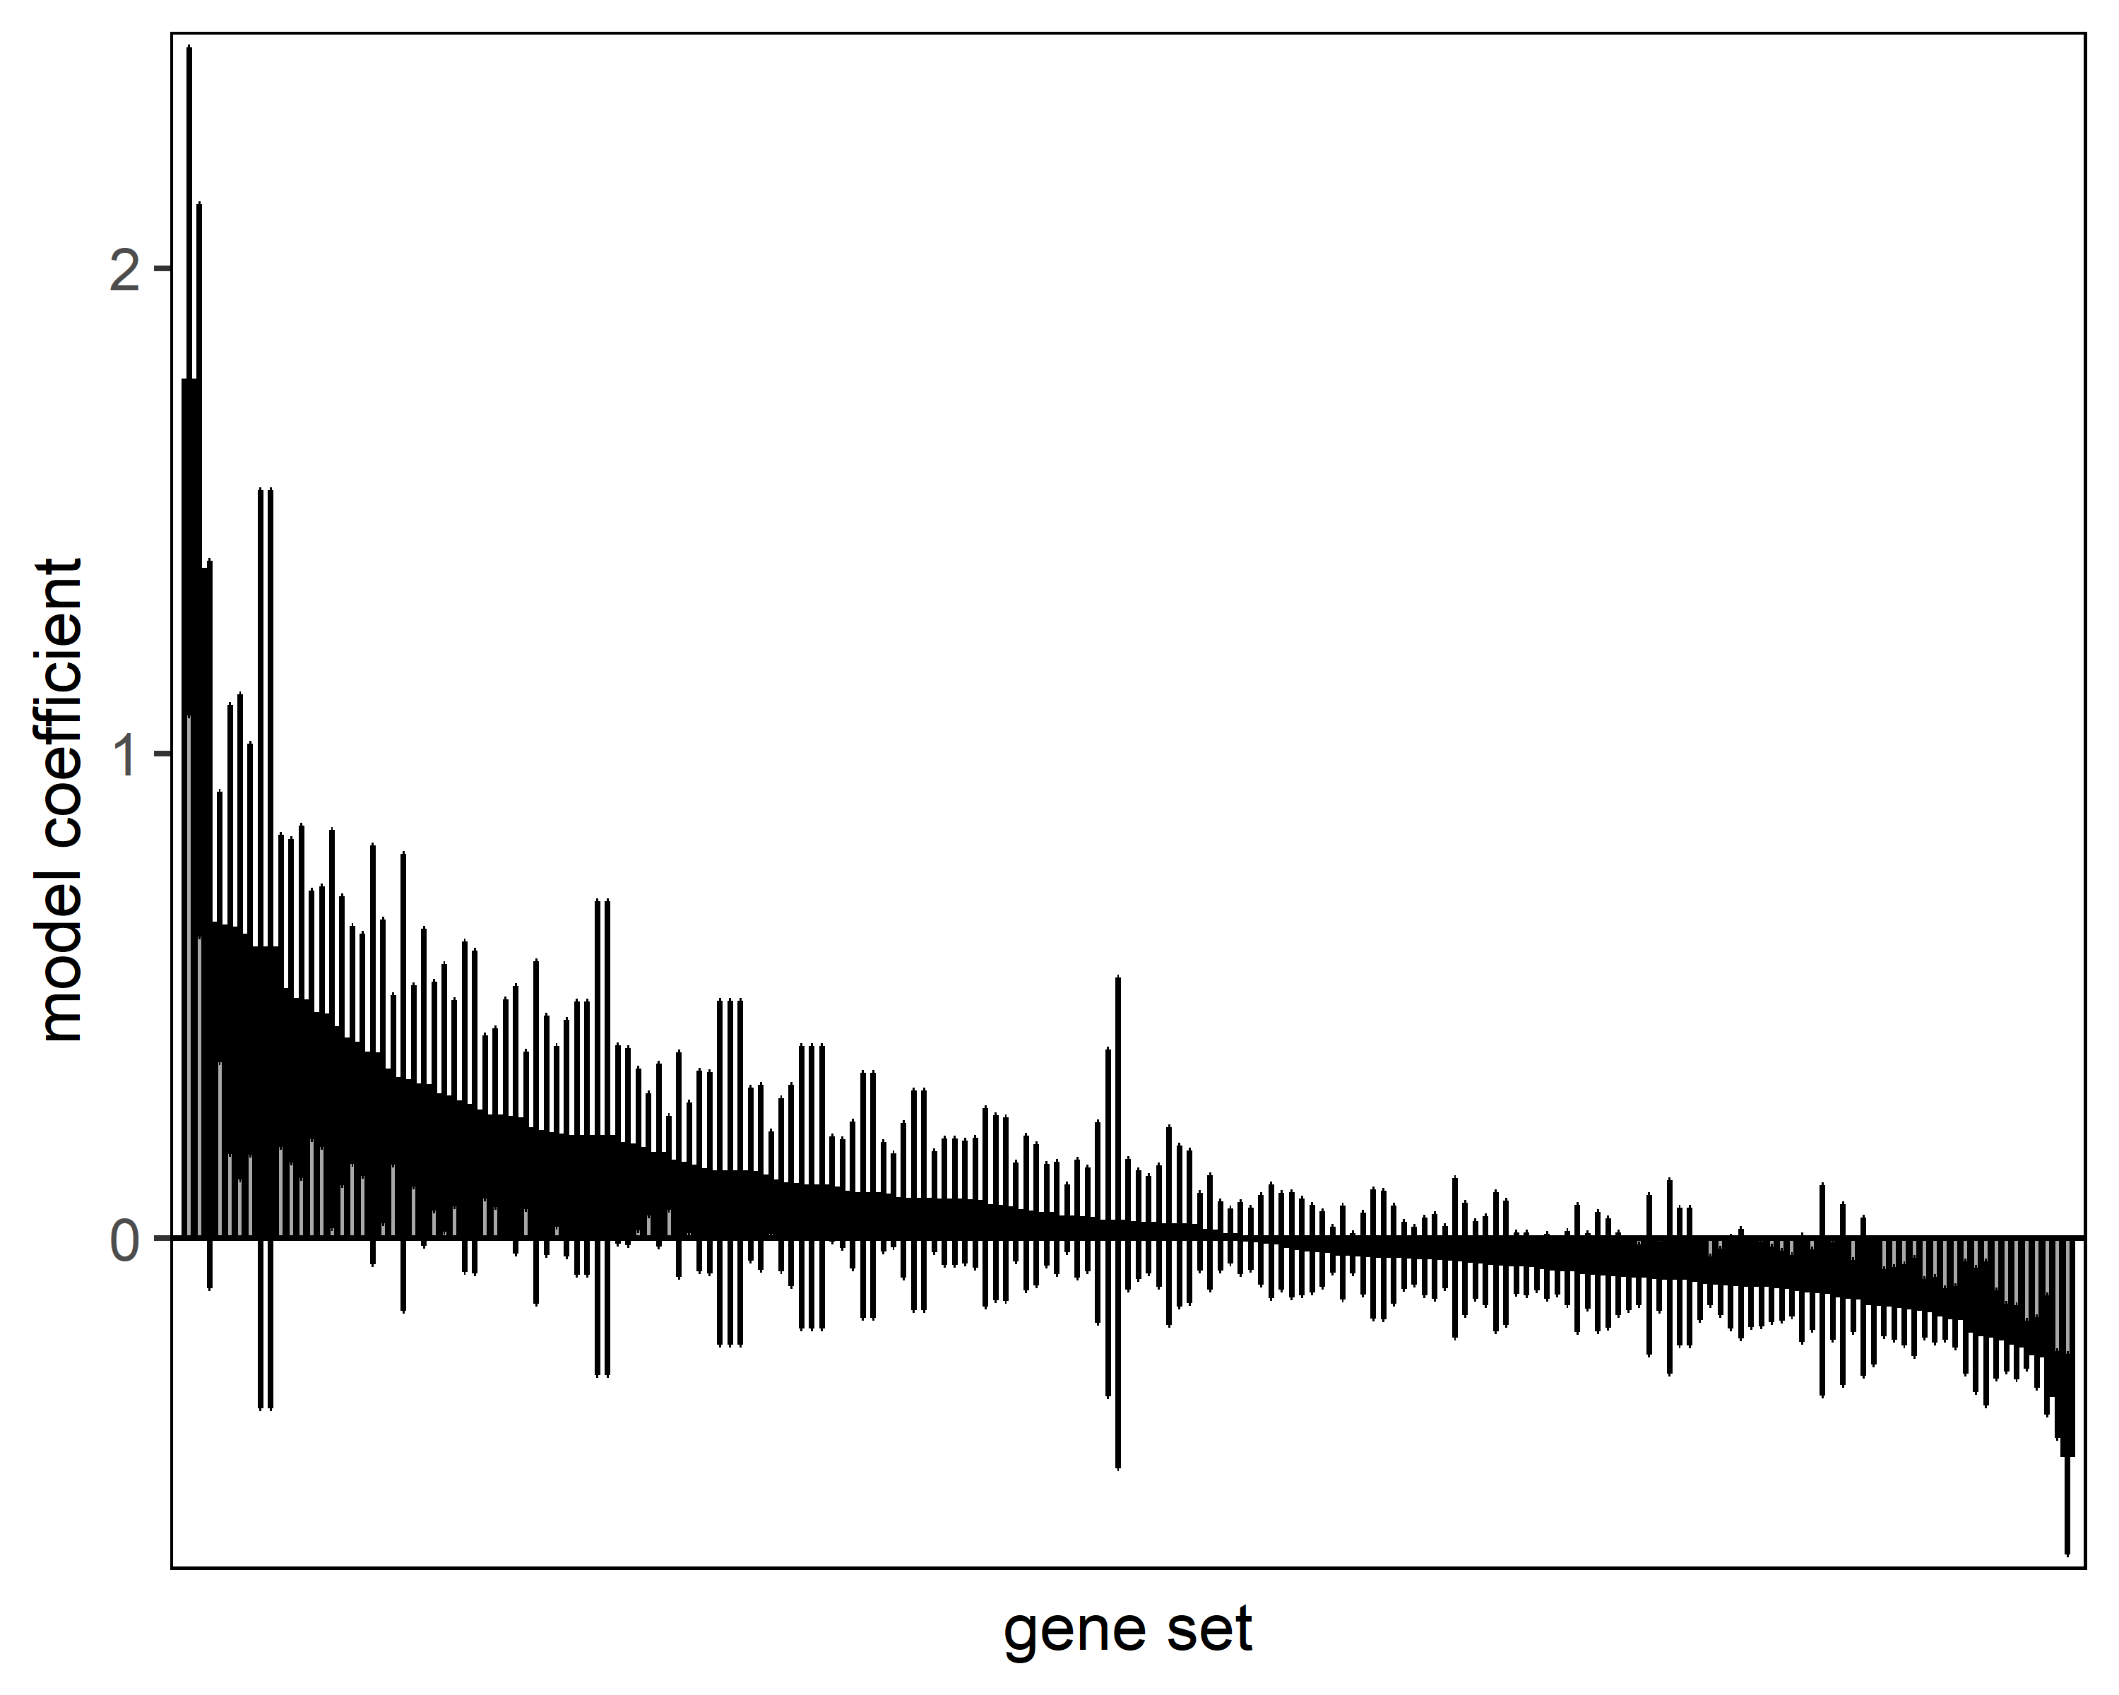
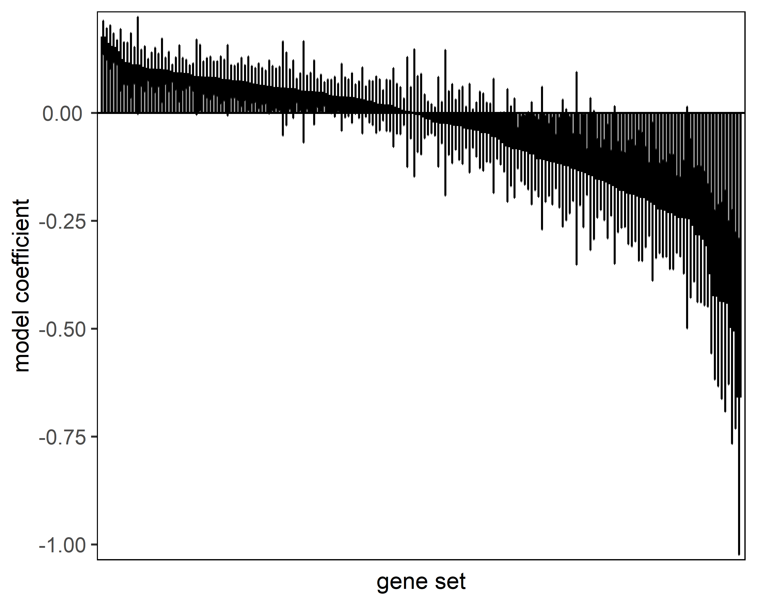
A
B
C
D
E

Slide 10
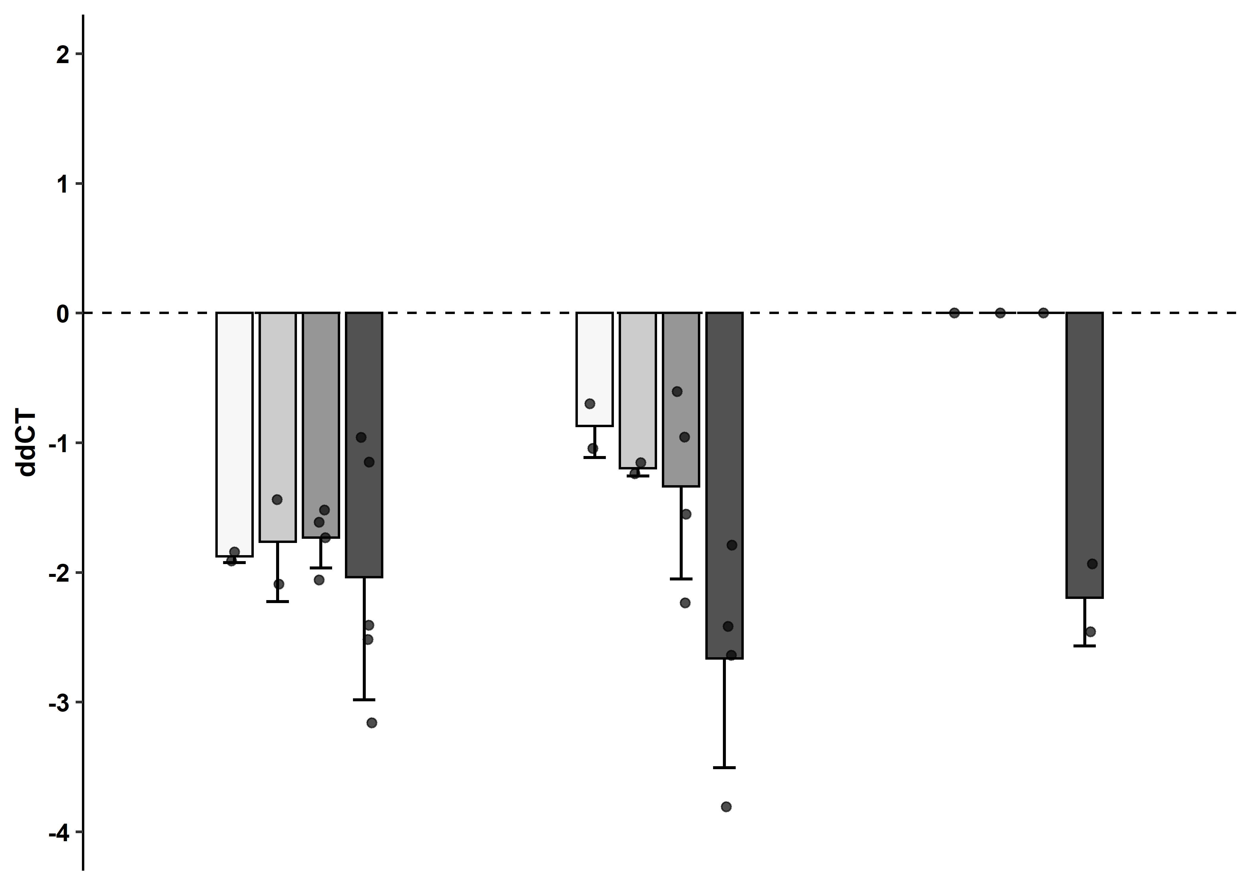
One-sample one-sided („less“) t-test with fdr adjustment for multiple testing
24 h
72 h
144 h
*
*
**
*
*
*
*
Transfection reagent
1.5 µL + - - - + - - - -
3 µL - + + + - + + + +
Antago-miR concentration
5 nM + + - - + + - - -
10 nM - - + - - - + - -
50 nM - - - + - - - + +
n = 2-5

Slide 11
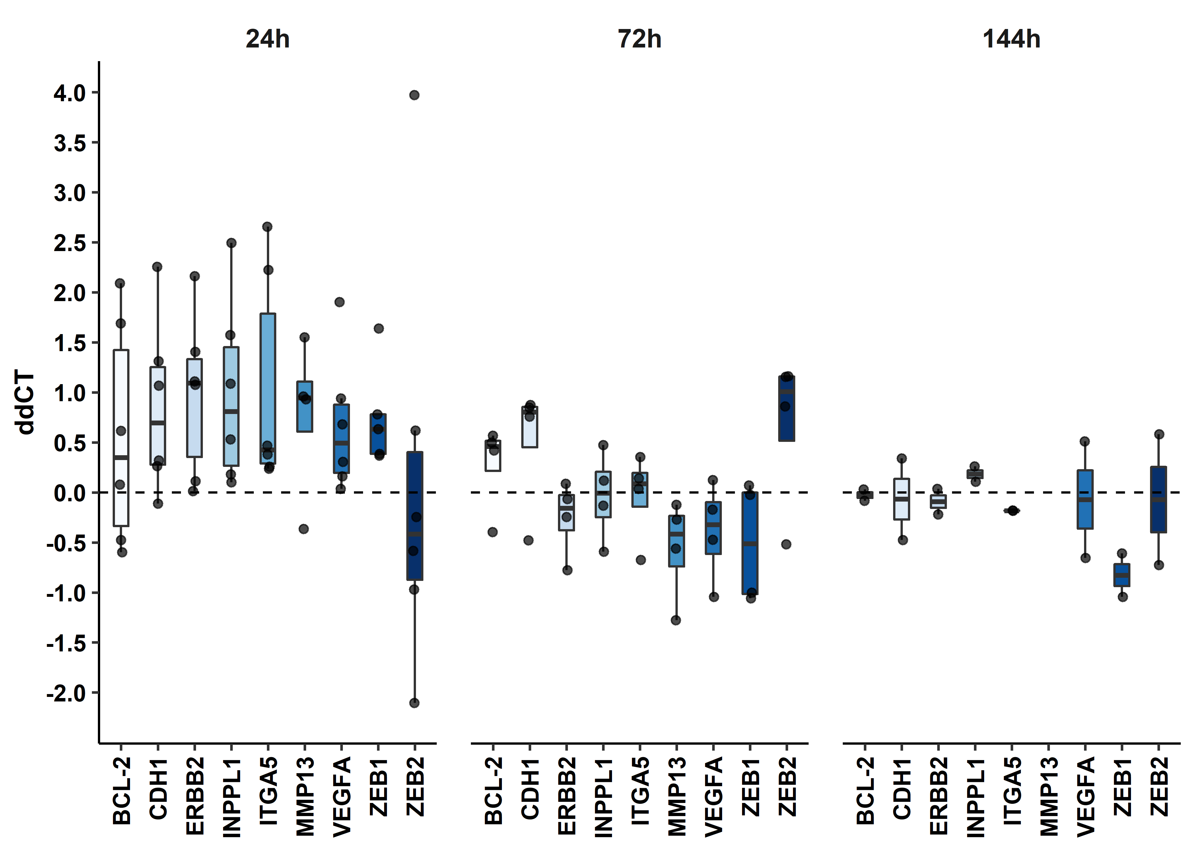
miR-205 Targets
-After fdr-adjustment to significant changes present
- But there is a trend towards upregulation of target genes after 24h
This trend is gone after 72h and at 144h protein levels in controls and knockout are the same

Slide 12
Growth curve
Template

Slide 13
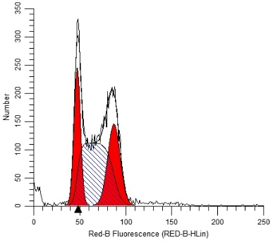
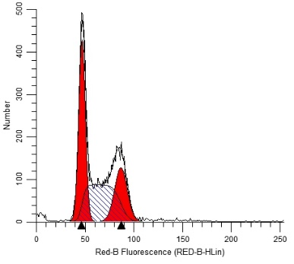
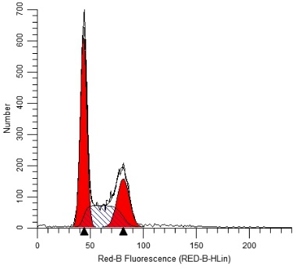
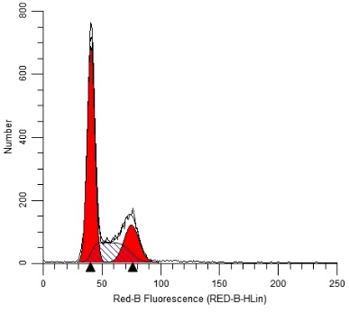
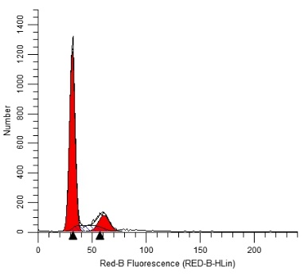
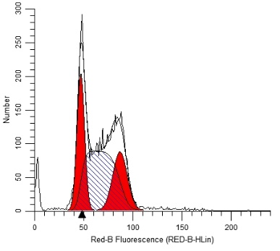
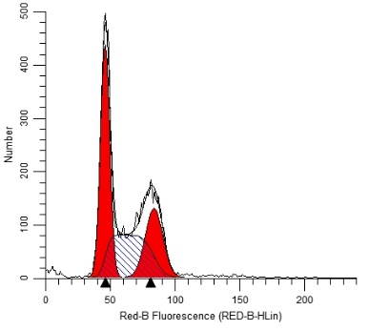
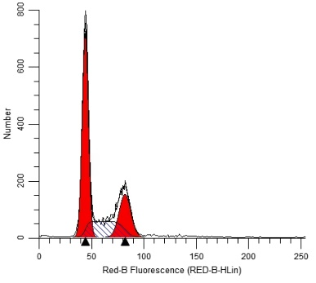
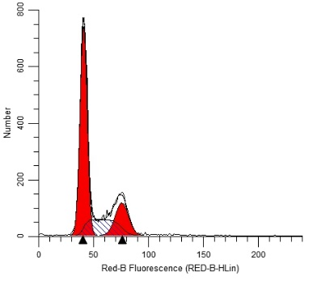
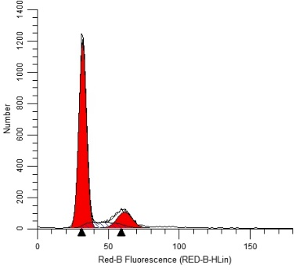
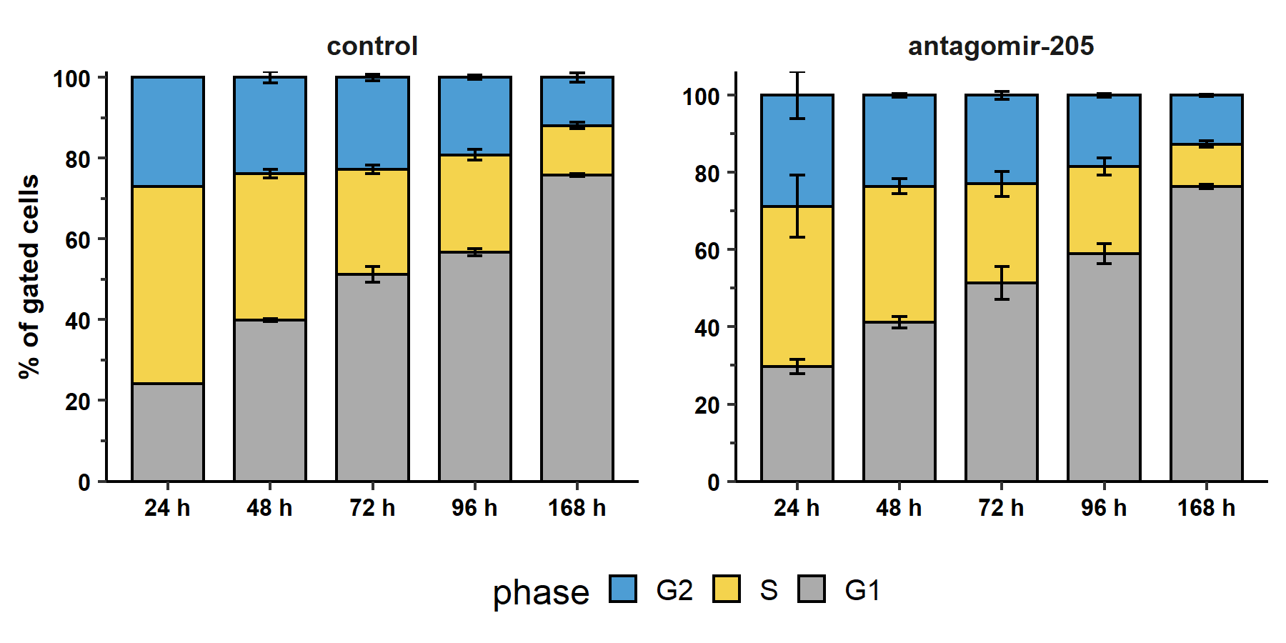

Cell cycle
A
24 h
48 h
72 h
96 h
168 h
B
Cell number
24 h
48 h
72 h
96 h
168 h
C
DNA content
A: Control
B: Antagomir-205
n = 2 (nochmal wiederholen)
Transfektion 24h nach Einsaat (abgelöste Zellen nach t24 noch nicht transfiziert)

Slide 14
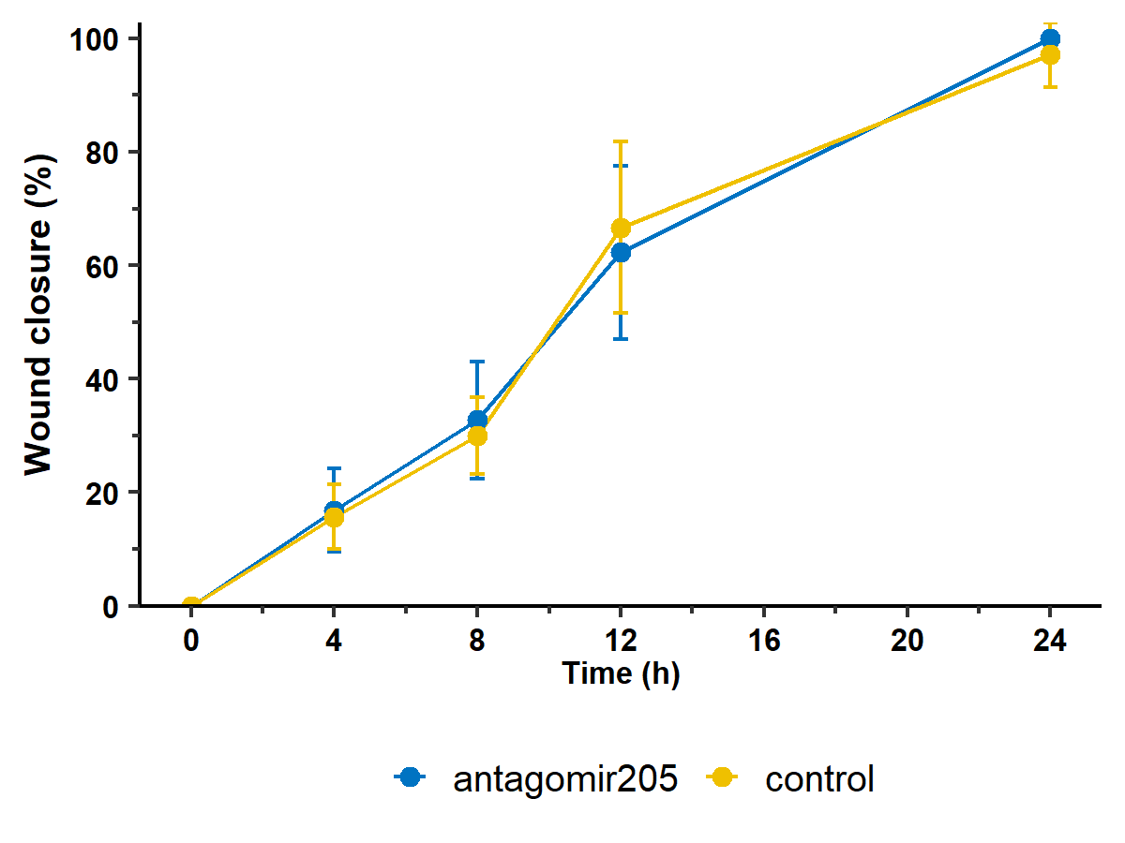
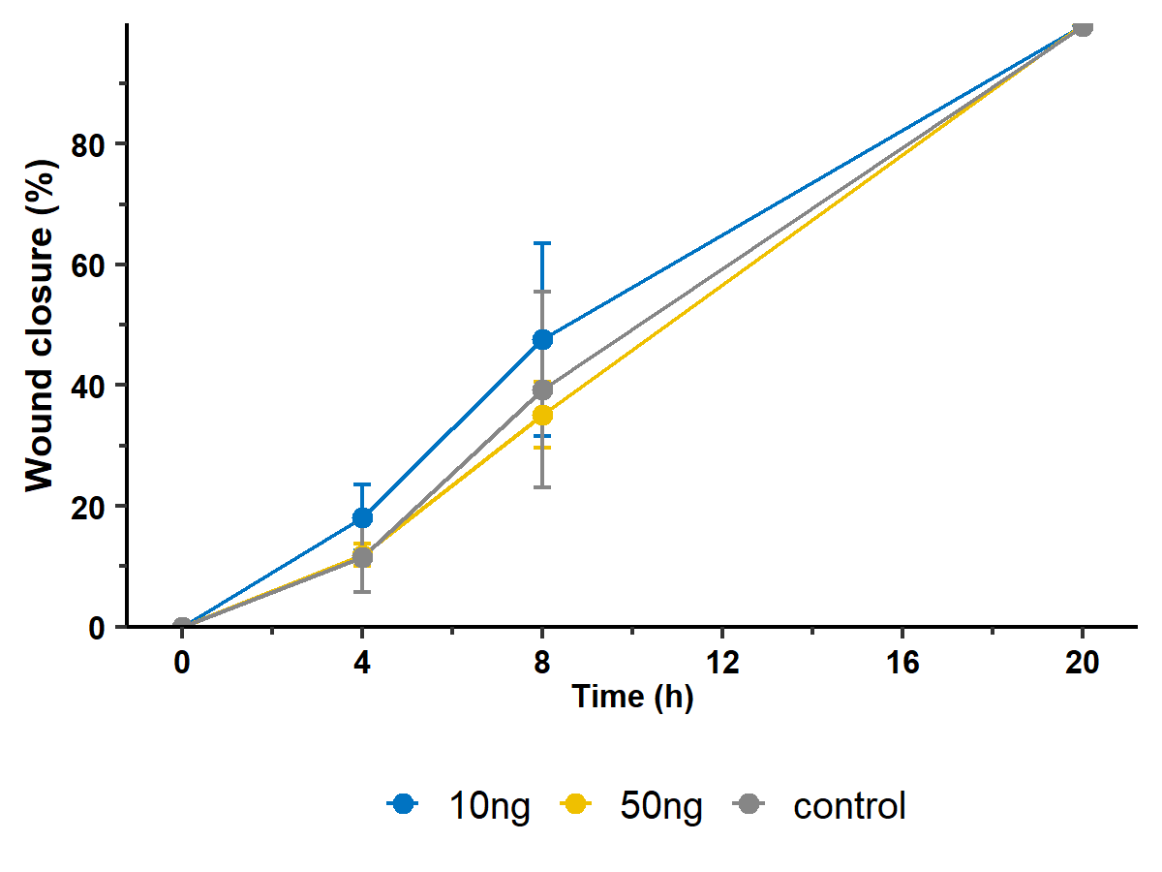
Scratch Assay (48h post transfection/ treatment)
miR-205
TGF-beta

Slide 15
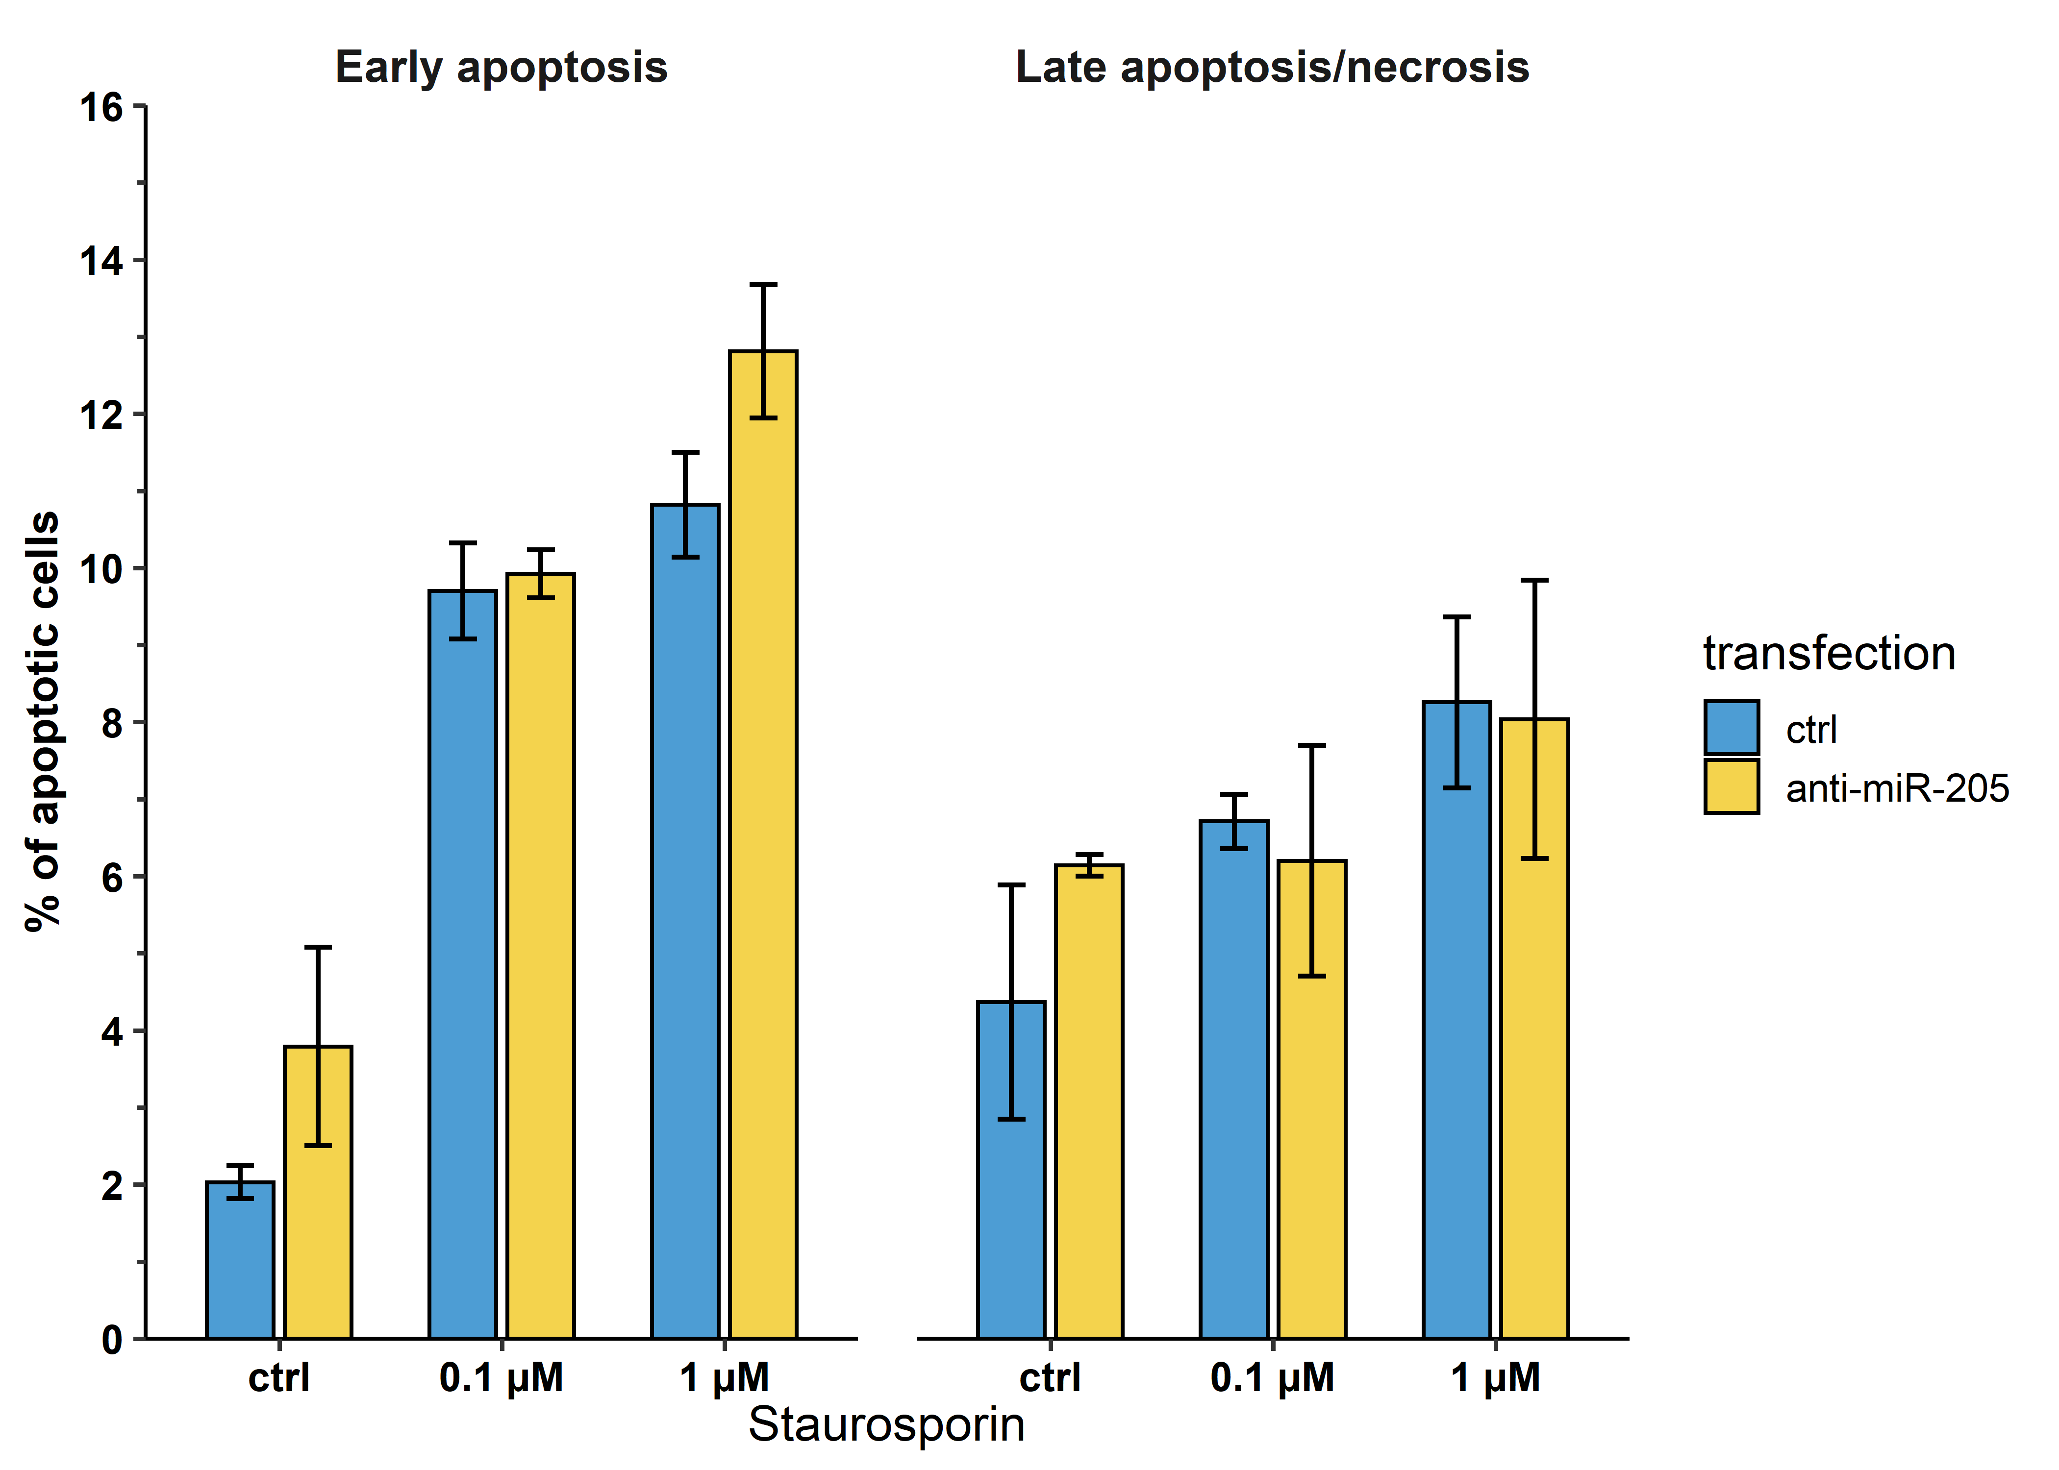
Apoptosis (gates dazu!)
No differences between transfected and untransfected cells
cells treated with staurosporin 24h post transfection
After 3h stauro treatment cells were harvested
Only differences are between cells without Staurosporin treatment and cells treated with increasing conc. Of Stauro for early apoptosis
Brauch ich überhaupt Stat test?

Slide 16
Konzentrationsbestimmung TGF-b I
control
10 ng/mL TGF-β
50 ng/mL TGF-β
A
Vimentin
Vimentin
Vimentin
24 h
B
Vimentin
Vimentin
Vimentin
48 h
Notes:
20x magnification

Slide 17
ANHANG (Suppl.)

Slide 18
Gel Primer

Slide 19
KEGG
Rank | Category | Subcategory | Expected | Observed | Q-value
1 | KEGG (miRPathDB) | Small cell lung cancer | 1.4081 | 12 | 5.14E-10
2 | KEGG (miRPathDB) | Hepatitis B | 2.09346 | 12 | 3.67E-08
3 | KEGG (miRPathDB) | PI3K-Akt signaling pathway | 1.75701 | 11 | 2.12E-07
4 | KEGG (miRPathDB) | Estrogen signaling pathway | 0.909657 | 9 | 2.93E-07
5 | KEGG (miRPathDB) | Pathways in cancer | 2.66667 | 12 | 2.93E-07
6 | KEGG (miRPathDB) | Proteoglycans in cancer | 1.98131 | 11 | 4.09E-07
7 | KEGG (miRPathDB) | HTLV-I infection | 1.45794 | 10 | 4.85E-07
8 | KEGG (miRPathDB) | FoxO signaling pathway | 2.09346 | 11 | 5.67E-07
9 | KEGG (miRPathDB) | Adherens junction | 1.08411 | 9 | 6.80E-07
10 | KEGG (miRPathDB) | Focal adhesion | 1.60748 | 10 | 9.12E-07
11 | KEGG (miRPathDB) | VEGF signaling pathway | 0.523364 | 7 | 1.37E-06
12 | KEGG (miRPathDB) | Wnt signaling pathway | 0.82243 | 8 | 1.37E-06
13 | KEGG (miRPathDB) | Prostate cancer | 2.42991 | 11 | 1.83E-06
14 | KEGG (miRPathDB) | Acute myeloid leukemia | 0.984424 | 8 | 5.08E-06
15 | KEGG (miRPathDB) | Ras signaling pathway | 1.00935 | 8 | 5.80E-06
16 | KEGG (miRPathDB) | Chemokine signaling pathway | 0.672897 | 7 | 6.09E-06
17 | KEGG (miRPathDB) | NF-kappa B signaling pathway | 0.411215 | 6 | 6.15E-06
18 | KEGG (miRPathDB) | Gap junction | 0.461059 | 6 | 1.19E-05
19 | KEGG (miRPathDB) | Pancreatic cancer | 1.74455 | 9 | 2.33E-05
20 | KEGG (miRPathDB) | Neurotrophin signaling pathway | 1.27103 | 8 | 2.73E-05
Cancer and migration/invasion related pathways

Slide 20
GO
Rank | Category | Subcategory | Expected | Observed | Q-value
1 | Gene Ontology (miRWalk) | GO0000785 chromatin | 3.08688 | 12 | 8.08E-05
2 | Gene Ontology (miRWalk) | GO0040018 positive regulation of multicellular organism growth | 1.45145 | 10 | 8.08E-05
3 | Gene Ontology (miRWalk) | GO0072593 reactive oxygen species metabolic process | 1.55366 | 10 | 8.08E-05
4 | Gene Ontology (miRWalk) | GO0043209 myelin sheath | 1.20613 | 9 | 9.26E-05
5 | Gene Ontology (miRWalk) | GO0071230 cellular response to amino acid stimulus | 1.71721 | 10 | 9.26E-05
6 | Gene Ontology (miRWalk) | GO0006909 phagocytosis | 0.919932 | 8 | 1.51E-04
7 | Gene Ontology (miRWalk) | GO0007507 heart development | 3.4753 | 12 | 1.51E-04
8 | Gene Ontology (miRWalk) | GO0001541 ovarian follicle development | 2.63714 | 11 | 1.76E-04
9 | Gene Ontology (miRWalk) | GO0031953 negative regulation of protein autophosphorylation | 0.388416 | 6 | 1.76E-04
10 | Gene Ontology (miRWalk) | GO0032967 positive regulation of collagen biosynthetic process | 0.981261 | 8 | 1.76E-04
11 | Gene Ontology (miRWalk) | GO0030279 negative regulation of ossification | 1.43101 | 9 | 1.81E-04
12 | Gene Ontology (miRWalk) | GO0005068 transmembrane receptor protein tyrosine kinase adaptor activity | 0.69506 | 7 | 2.17E-04
13 | Gene Ontology (miRWalk) | GO0007155 cell adhesion | 3.78194 | 12 | 2.17E-04
14 | Gene Ontology (miRWalk) | GO0051402 neuron apoptotic process | 2.7598 | 11 | 2.17E-04
15 | Gene Ontology (miRWalk) | GO0009314 response to radiation | 2.08518 | 10 | 2.23E-04
16 | Gene Ontology (miRWalk) | GO0010224 response to uv b | 1.08348 | 8 | 2.49E-04
17 | Gene Ontology (miRWalk) | GO0001666 response to hypoxia | 3.9046 | 12 | 2.61E-04
18 | Gene Ontology (miRWalk) | GO0006461 protein complex assembly | 2.9029 | 11 | 2.61E-04
19 | Gene Ontology (miRWalk) | GO0006470 protein dephosphorylation | 2.94378 | 11 | 2.67E-04
20 | Gene Ontology (miRWalk) | GO0007179 transforming growth factor beta receptor signaling pathway | 3.98637 | 12 | 2.67E-04
Cancer and response to (UV) radiation/DNA damage response

Slide 21
Localization
Rank | Category | Subcategory | Expected | Observed | Q-value
1 | Localization (RNALocate) | exosome | 2.43464 | 11 | 1.98E-06
2 | Localization (RNALocate) | Cytoplasm | 2.0016 | 10 | 3.34E-06
3 | Localization (RNALocate) | Microvesicle | 3.33921 | 10 | 2.43E-04
4 | Localization (RNALocate) | Nucleus | 3.34884 | 10 | 2.43E-04
5 | Localization (RNALocate) | Nucleolus | 0.65437 | 5 | 4.90E-04
6 | Localization (RNALocate) | Circulating | 4.88853 | 11 | 6.07E-04
7 | Localization (RNALocate) | Mitochondrion | 3.20449 | 8 | 5.98E-03
8 | Localization (RNALocate) | Exosome | 8.28549 | 12 | 1.43E-02
9 | Localization (RNALocate) | microvesicle | 8.40096 | 12 | 1.51E-02
10 | Localization (RNALocate) | Extracellular vesicle | 0.80834 | 3 | 4.17E-02
Enriched in exosomes/microvesicles

Slide 22
Targets
Rank | Category | Subcategory | Expected | Observed | Q-value
1 | Target genes (miRTarBase) | ZEB1 | 0.201405 | 7 | 5.00E-07
2 | Target genes (miRTarBase) | DNMT3B | 0.0655738 | 5 | 1.68E-06
3 | Target genes (miRTarBase) | ZEB2 | 0.140515 | 6 | 1.68E-06
4 | Target genes (miRTarBase) | BCL2 | 0.313817 | 7 | 3.07E-06
5 | Target genes (miRTarBase) | JUN | 0.173302 | 6 | 3.07E-06
6 | Target genes (miRTarBase) | LMNB1 | 0.360656 | 7 | 5.86E-06
7 | Target genes (miRTarBase) | SHC1 | 0.0468384 | 4 | 2.43E-05
8 | Target genes (miRTarBase) | SIRT1 | 0.163934 | 5 | 8.06E-05
9 | Target genes (miRTarBase) | TPD52L1 | 0.0655738 | 4 | 8.06E-05
10 | Target genes (miRTarBase) | VEGFA | 0.562061 | 7 | 8.06E-05
- Targets like ZEB1/ZEB2, BCL2 and VEGFA are enriched → with the miRNAs being downregulated these targets are most likely upregulated
- The only miRNA that is consistently regulated after Irradiation is miR-205

Slide 23
To do
Check Significant tests
Barplots immer mit sd errorbar beidseitig? Punkte der einzelnen Proben dazu?
Apoptose Bilder vom Flusszytometer dazu!
Einheitliches color scheme

Slide 24
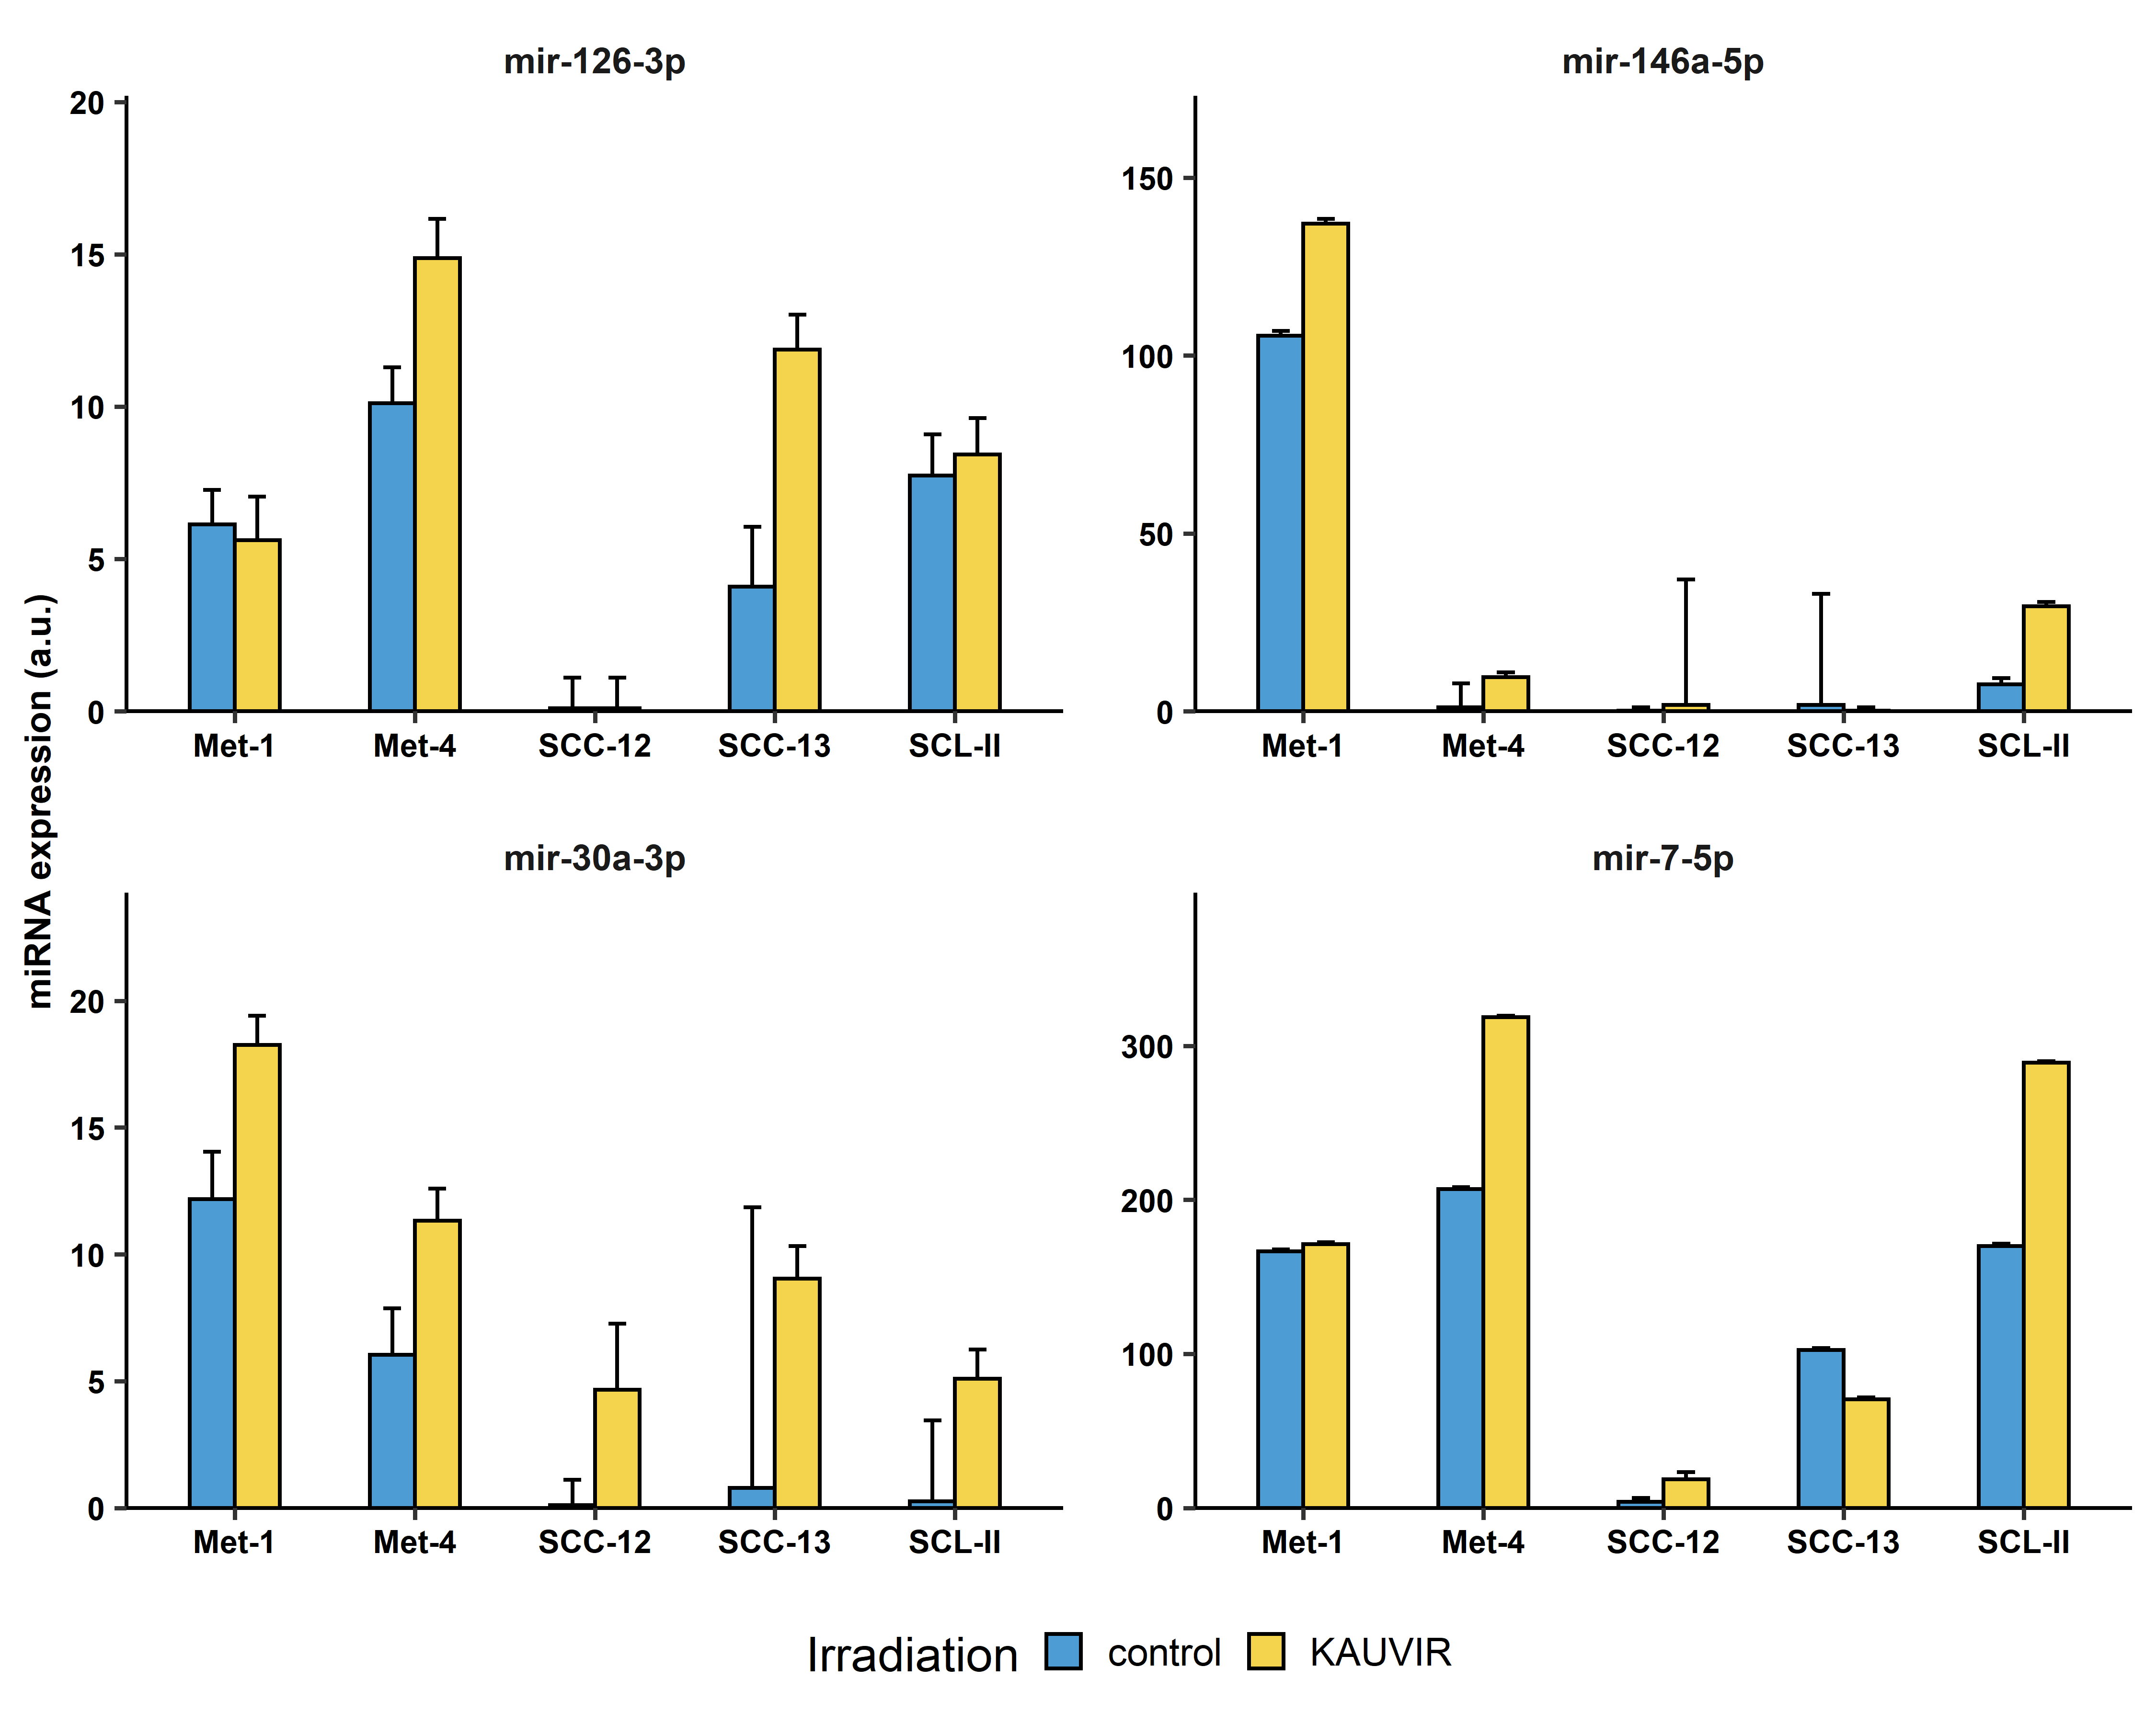

Slide 25
